Slide 2
I.Q. Test

Slide 3
I.Q. Test
1
If you went to bed
at 8:00 a.m. and
set the alarm to get
up at 9 o’clock the
next morning, how many hours of sleep would you get?
Answer: 25 Hours

Slide 4
I.Q. Test
2
Mr. and Mrs. Smith
have six daughters
and each daughter
has one brother.
How many people
are in the family?
Answer: 9

Slide 5
I.Q. Test
3
Why can’t a man living in Winston-Salem, North Carolina, be buried west of the Mississippi River?
Answer: Because he is alive

Slide 6
I.Q. Test
4
If you had a match and entered a room in which there was a kerosene lamp, an oil heater, and a wood-burning stove, which would you light first?
Answer: The match

Slide 7
I.Q. Test
5
Some months
have 30 days,
some have 31
days; how many months have
28 days?
Answer: All do

Slide 8
I.Q. Test
6
Which is
correct – eight
and eight IS fifteen
or eight and eight
ARE fifteen?
Answer: Neither

Slide 9
I.Q. Test
7
A farmer had 17 sheep; all but nine died. How many does he have left.
Answer: 9

Slide 10
I.Q. Test
8
Take two apples from three apples and what do you have?
Answer: 2 Apples

Slide 11
I.Q. Test
9
In the United
States is it legal
for a man to marry his widow’s sister?
Answer: No, he’s dead

Slide 12
I.Q. Test
10
How much dirt
is there in a hole that measures
2 feet by 3 feet
by 4 feet?
Answer: None

Slide 13
I.Q. Test
Bonus
What is 5 divided by a half plus 3?
Answer: 13
5 divided by .5 = 10 + 3

Slide 17
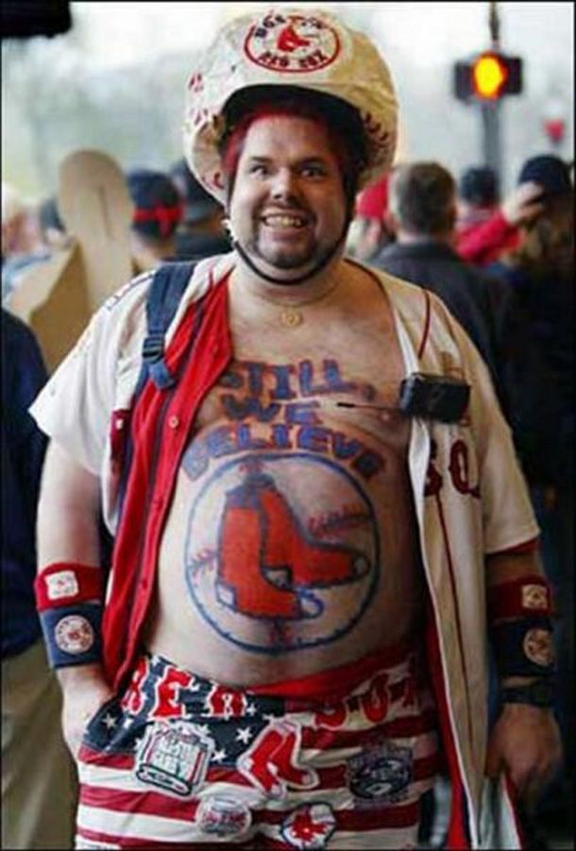

Slide 18
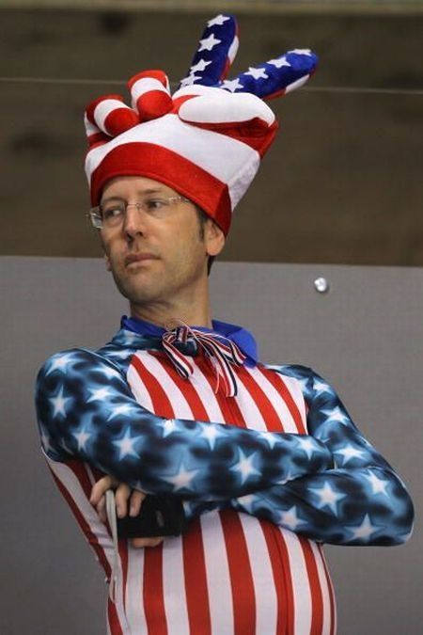

Slide 19
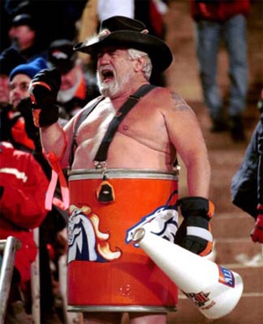

Slide 20
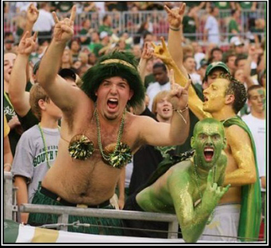

Slide 21
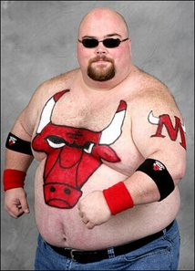

Slide 22
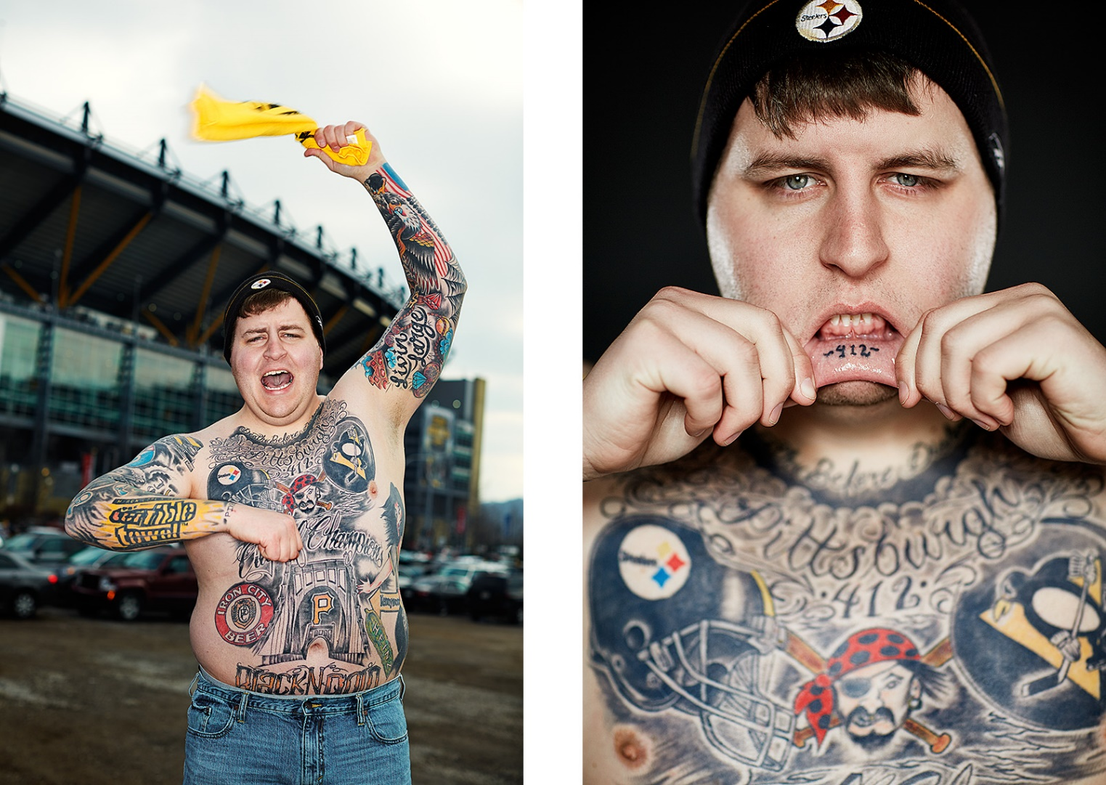

Slide 23
DOES JESUS WANT FANS
OR
FOLLOWERS?

Slide 24
Followers of Jesus don’t measure themselves against others to see how they are doing.

Slide 25
Followers of Jesus don’t just try to look and act Christian while their heart
stays unchanged.

Slide 26
Jesus wants followers who will deny themselves

Slide 27
Jesus wants followers who will pick up their cross and follow Him

Slide 29
DIAGNOSING FANDOM
QUESTION #1
Have you made a decision about Jesus, or have you committed to Jesus?

Slide 30
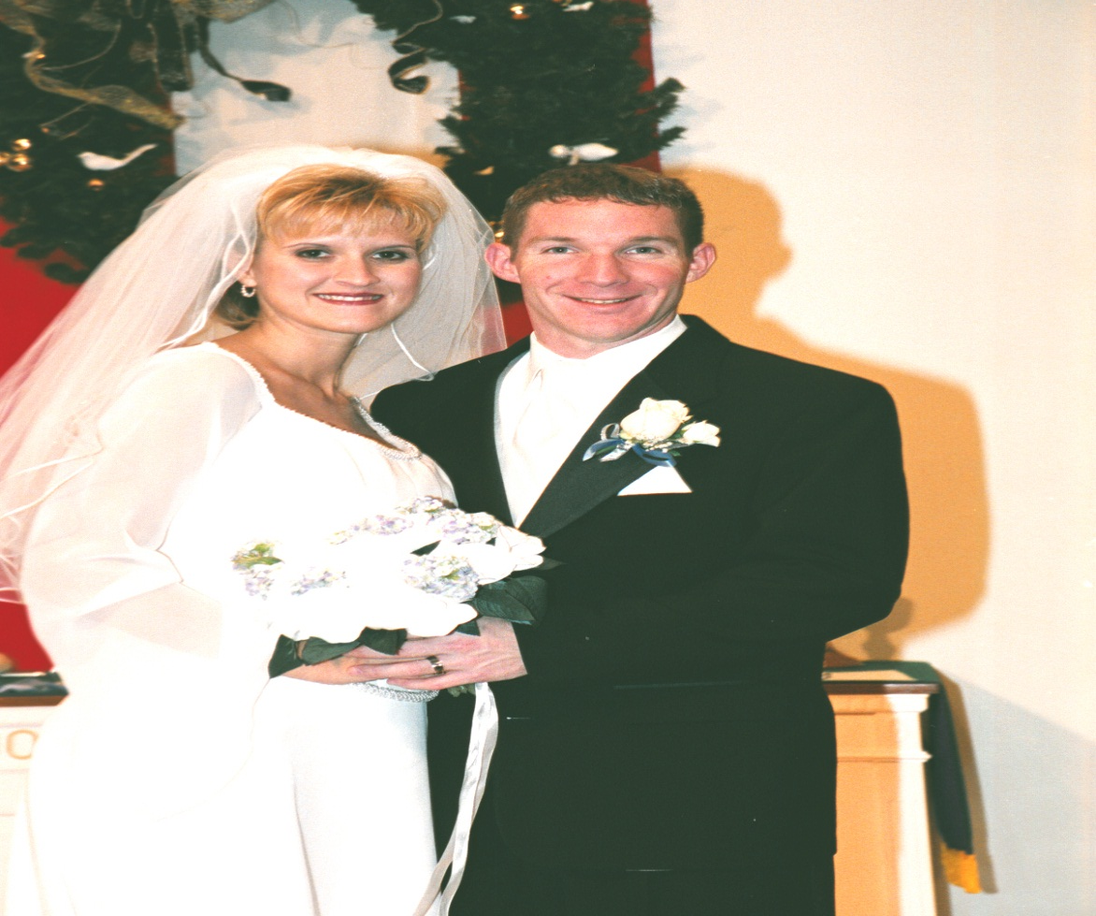

Slide 31
GREEK: “PISTIS”
Belief/affirmation
combined with a pledge to live out that belief

Slide 32
So you see, it isn't enough just to have faith. Faith that doesn't show itself by good deeds is no faith at all -- it is dead and useless… Just as the body is dead without a spirit, so also faith is dead without good deeds. ~ James 2:17,26

Slide 33
DIAGNOSING FANDOM
QUESTION #2
Do you just know about Jesus, or do you really, deeply know Him?

Slide 34
“This is the way to have eternal life—to know you the only true God and Jesus Christ whom you sent to earth.” ~ John 17:3

Slide 35
GREEK = “ginosko”
This is the Greek translation of a Jewish idiom involving true intimacy between a husband and wife.

Slide 36
DIAGNOSING FANDOM
QUESTION #3
Is Jesus one of many, or is He your one and only?

Slide 37
“So honor the Lord and serve
him wholeheartedly. Put away forever the idols your ancestors worshiped when they lived
beyond the Euphrates River and in Egypt. Serve the Lord alone.”
~ Joshua 24:14

