Slide 1


Slide 2
THE EBAY
CHALLENGE

Slide 3
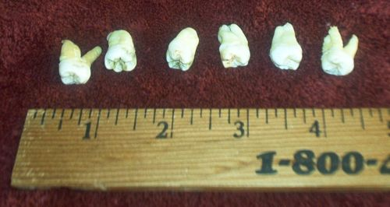
Actual Human Teeth
More or Less than $18?

Slide 4
Actual Human Teeth
ANSWER: More – $22.50

Slide 5
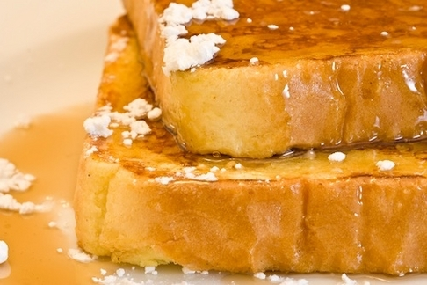
French Toast Partially Eaten by Justin Timberlake
More or Less than $750?

Slide 6
French Toast Partially Eaten by Justin Timberlake
ANSWER: More -- $1025

Slide 7
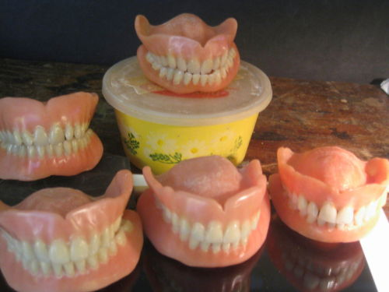
USED DENTURES
More or Less than
$500

Slide 8
USED DENTURES
ANSWER: More -- $750

Slide 9
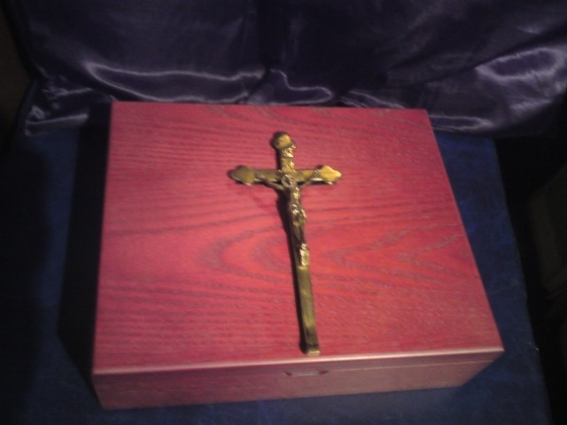
VAMPIRE SLAYER KIT
More or Less than $1000

Slide 10
VAMPIRE SLAYER KIT
ANSWER: More -- $1275.82

Slide 11
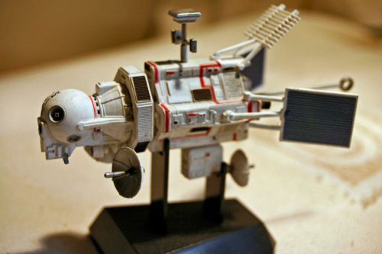
UFO DETECTOR
More or Less than
$75

Slide 12
UFO DETECTOR
ANSWER: Less -- $13.56

Slide 13
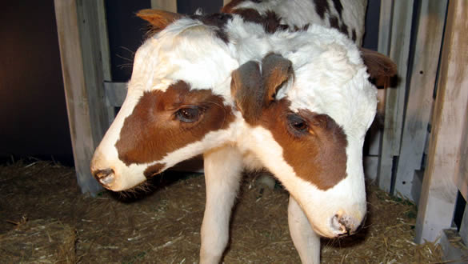
TWO-HEADED CALF
More or Less than
$100

Slide 14
TWO-HEADED CALF
ANSWER –
Did not Sell

Slide 15

Great Book!!!
More or Less than
$8.99

Slide 16
Great Book!!!
ANSWER:
More! – $11.56

Slide 17

Real Hornet’s Nest
More or Less than
$5

Slide 18
Real Hornet’s Nest
ANSWER: Less –
$2.55

Slide 19
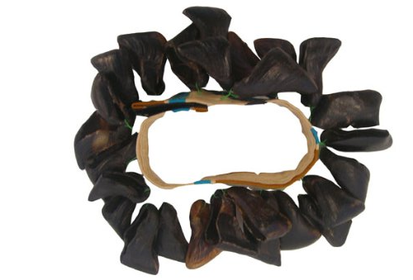
Goat Toenail Bracelet
More or Less than
$10

Slide 20
Goat Toenail Bracelet
ANSWER:
Did not Sell

Slide 21


Slide 22
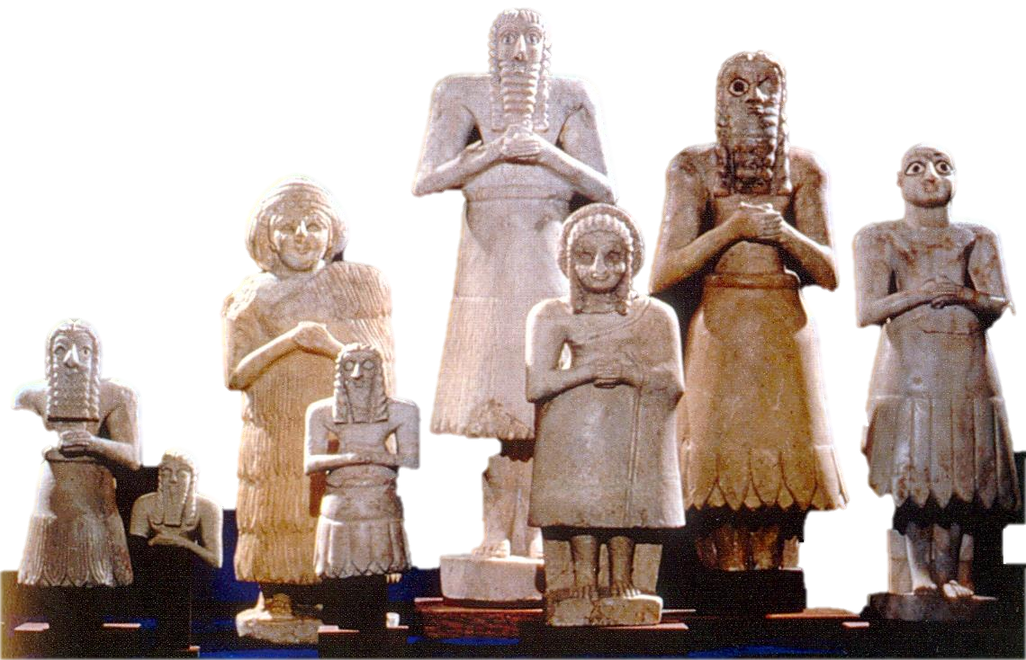

Slide 23
An idol is anything that seeks to take
God out of first place in your heart.

Slide 24
Guard your heart above all else, for it determines the course of your life. ~ Prov. 4:23

Slide 25


Slide 26
Pleasure

Slide 27
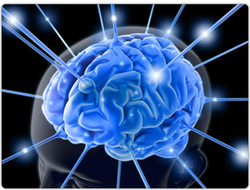
TV Shows
Video games
Sports
Books
Mags.
Food
Movies
Internet

Slide 28
My pleasure
Make me happy
Make
Me
Feel good
Give me what I want
Live for me
Do what I want

Slide 29
GOD
GOD
GOD
GOD
GOD
GOD
GOD
GOD
GOD
GOD
GOD
GOD
GOD
GOD

Slide 30
God, You will show me the way of life, granting me the joy of your presence and the pleasures of living with You forever.
~ Psalm 16:11

Slide 31
Stuff

Slide 32
CULTURAL LIE
MORE IS BETTER

Slide 33
BIBLICAL TRUTH
JESUS IS BETTER

Slide 34
Peers
Friends
Family
Celebrities

Slide 35
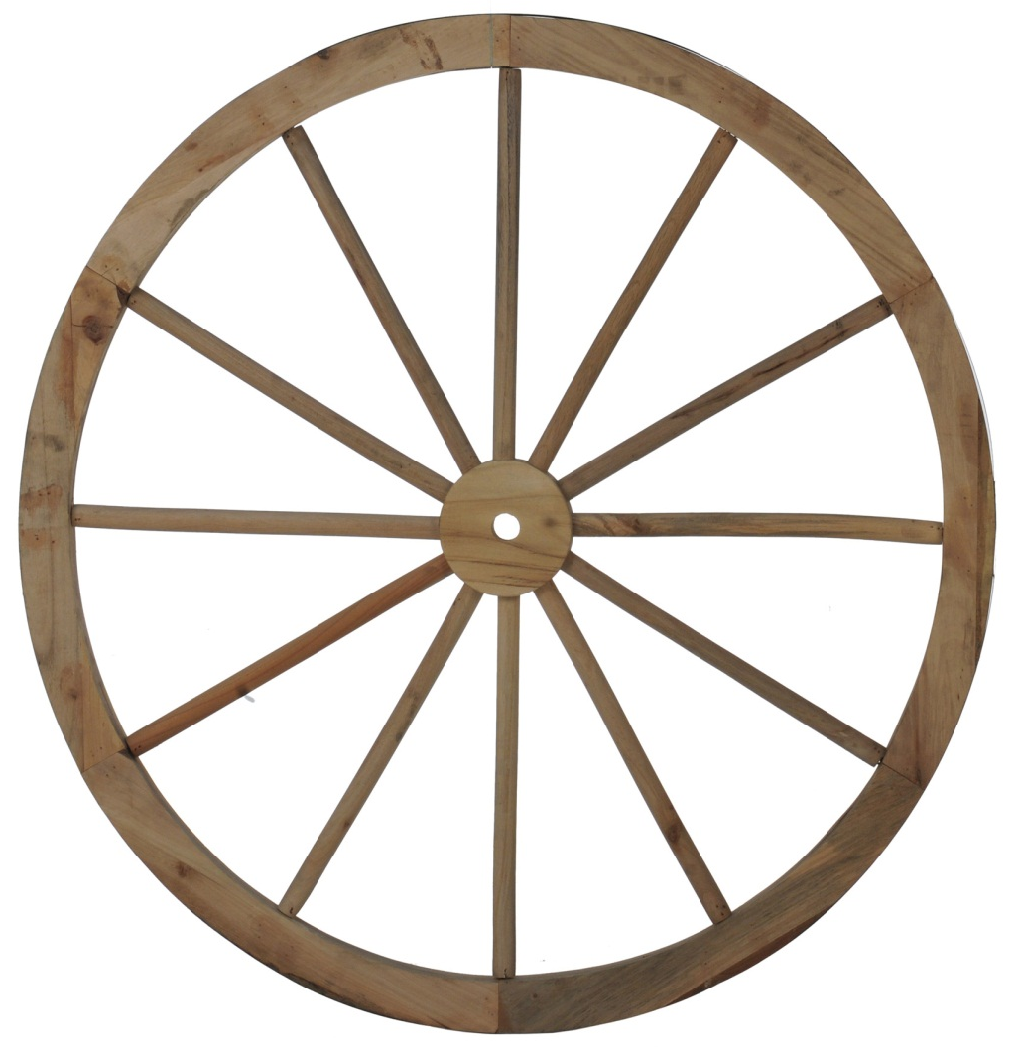
Something will always be in the center
FAMILY
FRIENDS
PEERS
CELEBRITIES
GOD

Slide 36
FAMILY
FRIENDS
BEST
FRIEND
PEERS
CELEBRITIES
GOD

Slide 37

When that person or thing disappears, what is holding the wheel together?
FAMILY
PEERS
CELEBRITIES
GOD

Slide 38
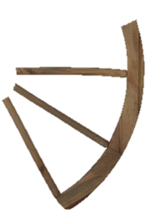
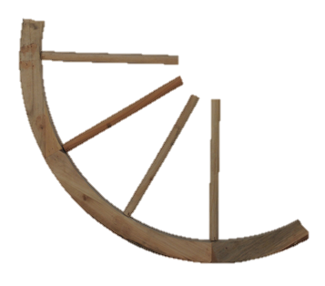
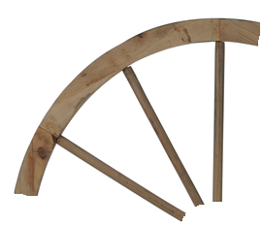
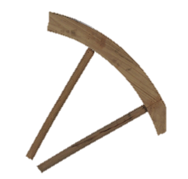

Slide 39
FAMILY
GOD
PEERS
FRIENDS
CELEBRITIES

Slide 40
GOD MUST BE:
Your first relationship
Your greatest relationship
Your deepest love
Your best friend

Slide 41
Money
Fame
Achieve
Succeed

Slide 42

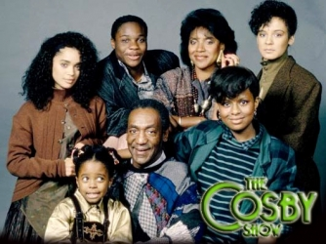
From 1967 to 1997
The top lessons taught on TV shows were: Community, kindness, image, traditional values, and acceptance

Slide 43


From 1997 on
the top lessons taught on TV shows were: fame, achievement, popularity, image, and being rich.

Slide 44
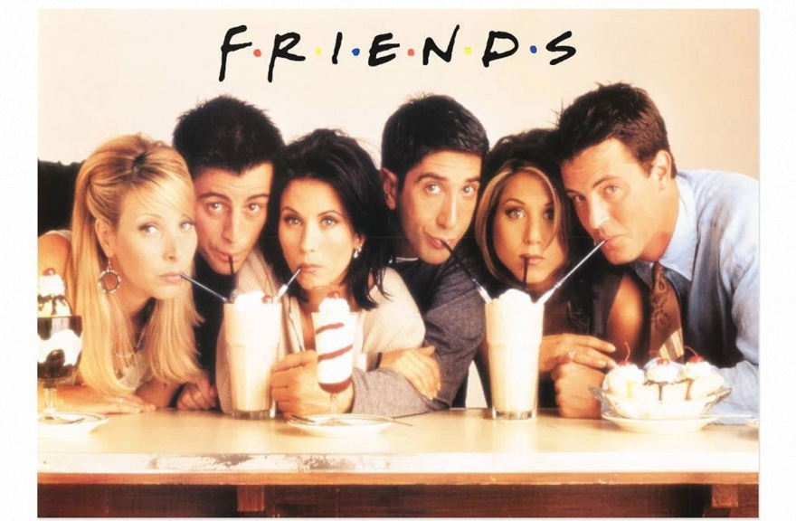

Meanwhile, from 1997 on, kindness dropped to #12, and traditional values to #15 on the list

Slide 45





Slide 46
The master said, “Well done, good and faithful servant.”
God measures success by:
  Faithfulness
  Obedience to Scripture
  Love

Slide 47
Money
Fame
Achieve
Success

Slide 48


Slide 49


Slide 50
Money
Fame
Achieve
Success

Slide 51


Slide 52
Money
Fame
Achieve
Success

