Slide 2
To the Heart of the Matter Trivia

Slide 3
# 1
How many chambers would you find in the average heart?
A. 1 C. 3
B. 2 D. 4

Slide 4
# 1
How many chambers would you find in the average heart?
A. 1 C. 3
B. 2 D. 4

Slide 5
# 2
Which of these is NOT a part of the human heart?
A. Septum C. Artium
B. Ventricle D. Atrium

Slide 6
# 2
Which of these is NOT a part of the human heart?
A. Septum C. Artium
B. Ventricle D. Atrium

Slide 7
# 3
On average, how many times does a human heart beat?
A. 40-50 C. 60-70
B. 50-60 D. 70-80

Slide 8
# 3
On average, how many times does a human heart beat?
A. 40-50 C. 60-70
B. 50-60 D. 70-80

Slide 9
# 4
How much does the average human heart weigh?
A. 11 ounces C. 1 ½ pounds
B. 15 ounces D. 2 ¼ pounds

Slide 10
# 4
How much does the average human heart weigh?
A. 11 ounces C. 1 ½ pounds
B. 15 ounces D. 2 ¼ pounds

Slide 11
# 5
What part of the body protects the heart from injury?
A. The diaphragm C. The lungs
B. The breastbone D. The pericardial cavity

Slide 12
# 5
What part of the body protects the heart from injury?
A. The diaphragm C. The lungs
B. The breastbone D. The pericardial cavity

Slide 13
# 6
How many gallons of blood does the average adult heart pump everyday?
A. 1 gallon C. 2400 gallons
B. 3800 gallons D. 4300 gallons

Slide 14
# 6
How many gallons of blood does the average adult heart pump everyday?
A. 1 gallon C. 2400 gallons
B. 3800 gallons D. 4300 gallons

Slide 15
# 7
Which of these songs is not a hit song of the band “Heart” from the late 80s and early 90s?
A. These Dreams C. You Were Warned
B. Alone D. Back to Avalon

Slide 16
# 7
Which of these songs is not a hit song of the band “Heart” from the late 80s and early 90s?
This song is by the Heart and Scissor Killers!
A. These Dreams C. You Were Warned
B. Alone D. Back to Avalon

Slide 17
# 8
Which of these devises might you use if you had an “abnormal heart rhythm”?
A. Pacemaker C. Respirator
B. Defibrillator D. Generator

Slide 18
# 8
Which of these devises might you use if you had an “abnormal heart rhythm”?
A. Pacemaker C. Respirator
B. Defibrillator D. Generator

Slide 19
# 9
True or False:
The human body needs cholesterol to live.
TRUE FALSE

Slide 20
# 9
True or False:
The human body needs cholesterol to live.
TRUE FALSE

Slide 21
# 10
What would too much cholesterol in your heart cause?
A. Heart Attack C. Heart Disease
B. Stroke D. Angina

Slide 22
# 10
What would too much cholesterol in your heart cause?
A. Heart Attack C. Heart Disease
B. Stroke D. Angina

Slide 23
# 11
Which of these types of Cholesterol is the “bad” cholesterol?
A. HDL C. VLDL
B. LDL D. LL Cool J

Slide 24
# 11
Which of these types of Cholesterol is the “bad” cholesterol?
A. HDL C. VLDL
B. LDL D. LL Cool J

Slide 25
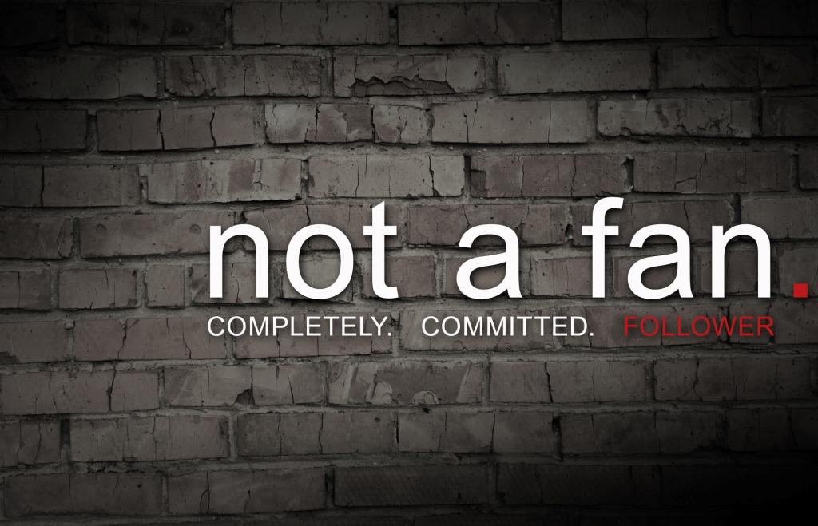

Slide 28
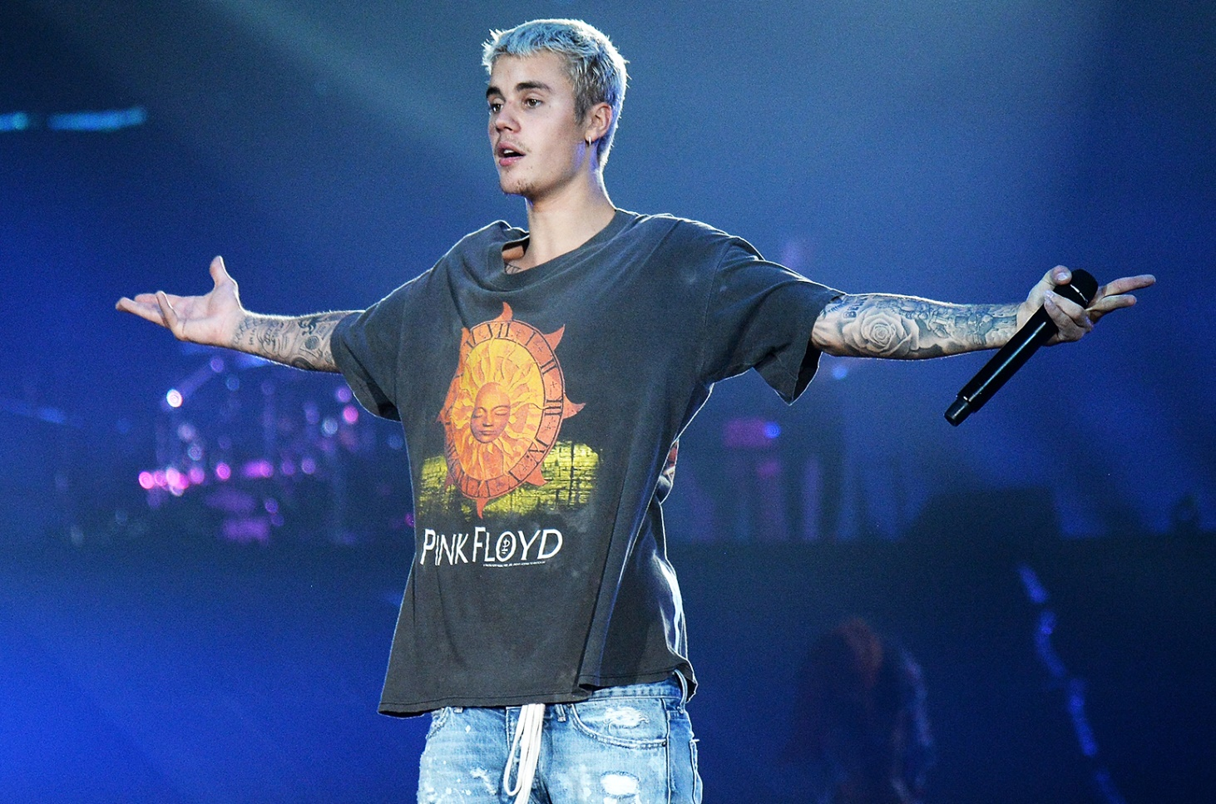

Slide 29
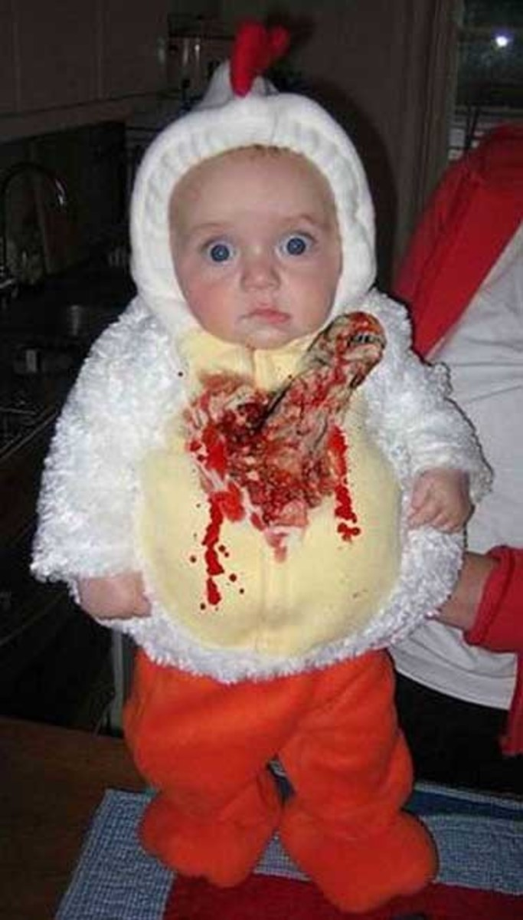

Slide 30
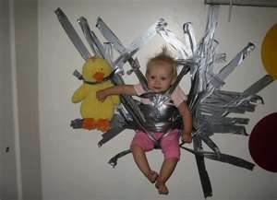

Slide 31
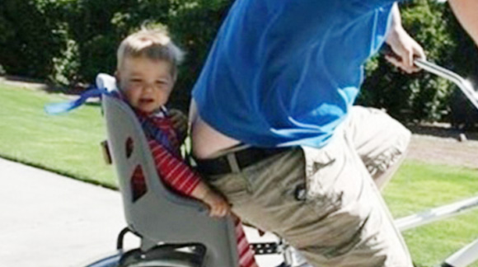

Slide 32
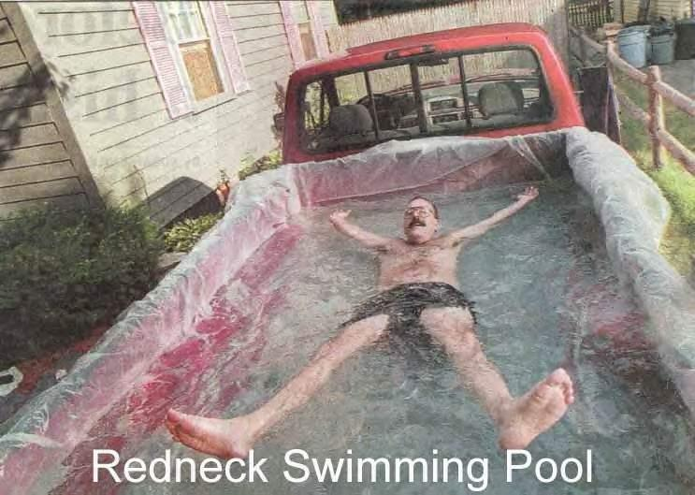

Slide 33
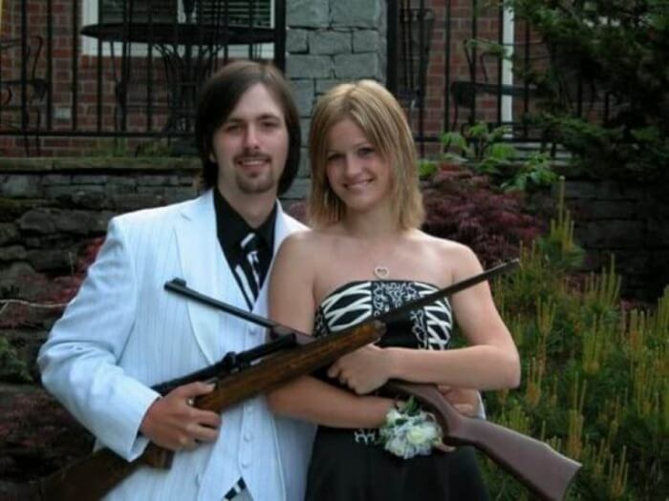

Slide 34
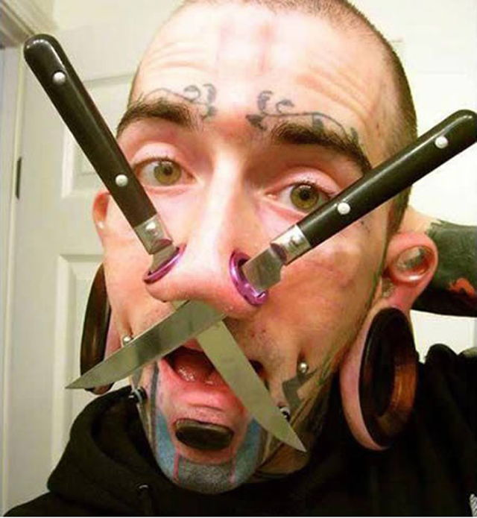

Slide 35
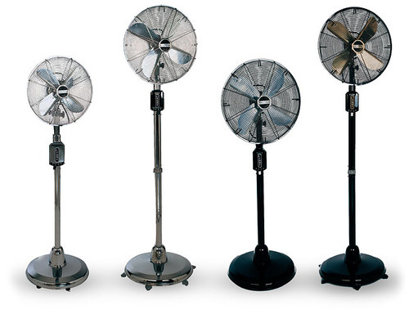

Slide 36
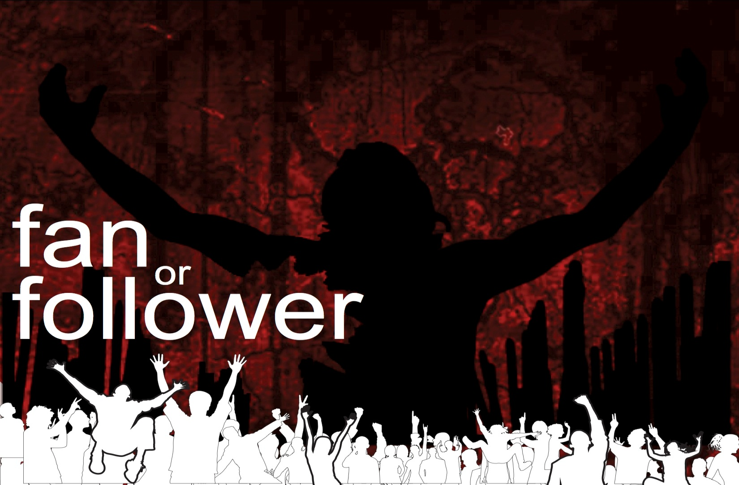

Slide 37
Jesus wants followers who measure themselves against Him and don’t simply try to act “Christian.”

Slide 38
SIX
DIAGNOSING
QUESTIONS

Slide 39
“It’s not that fans don’t want to have a relationship with Jesus, they just want one on their own terms. The question is, though, what kind of relationship does Jesus want to have with us?”

Slide 40
Then he said to them all: “If anyone would come after me, he must deny himself and take up his cross daily and follow me.” ~ Luke 9:23

Slide 41
ALL/ANYONE
~ Not just grown adults
~ Not just pastors
~ Not just missionaries
Jesus calls EVERYONE

Slide 42
ALL/ANYONE
~ Not just the “perfect” ones
~ Not just those who “have it
all together”
~ Not just those who only sin
“a little”

Slide 43
COME AFTER
=
“Passionate pursuit”

Slide 44
“The Kingdom of Heaven is like
a treasure that a man discovered hidden in a field. In his excitement, he hid it again and sold everything he owned to get enough money
to buy the field.” ~ Matthew 13:44

Slide 45
Do you have stories about
your pursuit of Jesus
that make people
say, “That’s crazy”?

Slide 46
Then he said to them all: "If anyone would come after me, he must deny himself and take up his cross daily and follow me.” ~ Luke 9:23

Slide 49
Jesus makes NO room for “flexitarian Christians”
There are no “exception clauses.” You are either
all in or all out.

Slide 50
Jesus, I’ll follow You but…
Don’t make me give up my stuff. I deserve it
Don’t tell me what TV shows and movies I can watch. I’ll watch what I want.

Slide 51
Jesus, I’ll follow You but…
Don’t tell me to wait until I am married for sex. We’re in love.
Don’t tell me to get up on Sundays and go to church, I need to sleep in that day

Slide 52
Jesus, I’ll follow You but…
Don’t tell me to give 10% of MY money to the church. I don’t have that much and I have stuff I want to get…
Etc. etc.

Slide 53
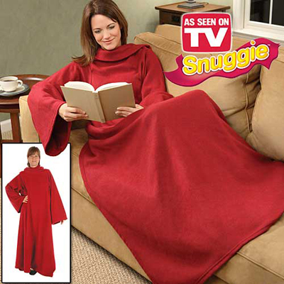

Slide 55
If you are NOT denying yourself and picking up your cross, then you are probably NOT a follower of Christ.
You are a fan.

