Slide 1


Slide 2
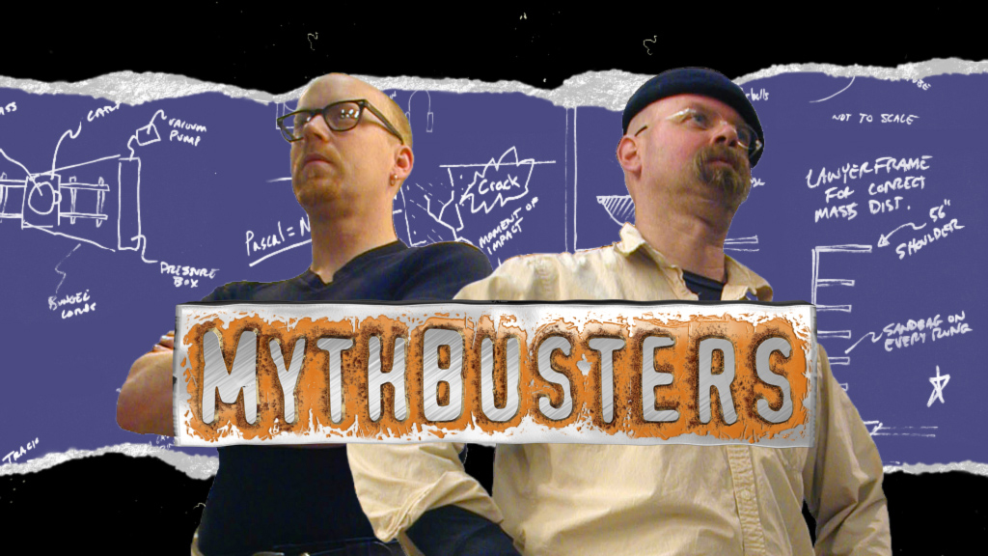

Slide 3
Are you as smart as Ryan and Jaime? Can you spot what is true (CONFIRMED) or what is FALSE (BUSTED)?

Slide 4
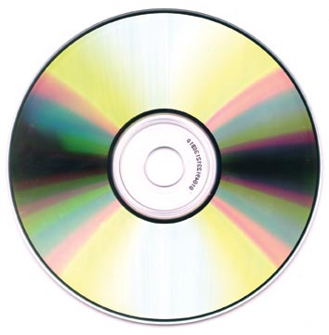
1. A person can beat police radar by hanging CDs from the rearview mirror.
A. Confirmed
B. Busted

Slide 5
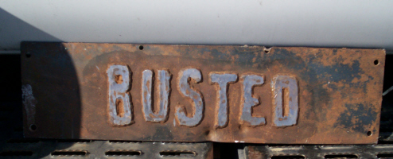
1. A person can beat police radar by hanging CDs from the rearview mirror.
A. Confirmed
B. Busted

Slide 6
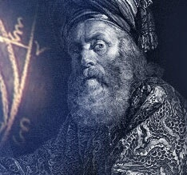
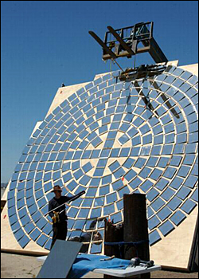
2. Archimedes built a working death ray to ignite Roman vessels
A. Confirmed
B. Busted

Slide 7
2. Archimedes built a working death ray to ignite Roman vessels
A. Confirmed
B. Busted

Slide 8
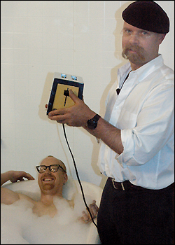
3. A person can die by dropping an electrical appliance into their bath water
A. Confirmed
B. Busted

Slide 9
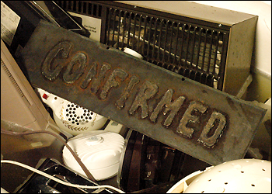
3. A person can die by dropping an electrical appliance into their bath water
A. Confirmed
B. Busted

Slide 10
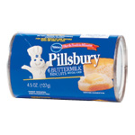
4. A can of biscuit dough exploded in a hot car and hit the driver's head
A. Confirmed
B. Busted

Slide 11
4. A can of biscuit dough exploded in a hot car and hit the driver's head
A. Confirmed
B. Busted

Slide 12
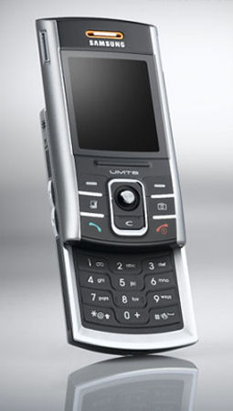
5. While driving, talking on a cell phone is as dangerous as being drunk
A. Confirmed
B. Busted

Slide 13
5. While driving, talking on a cell phone is as dangerous as being drunk
A. Confirmed
B. Busted

Slide 14

6. A house may explode from overuse of bug bombs
A. Confirmed
B. Busted

Slide 15
6. A house may explode from overuse of bug bombs
A. Confirmed
B. Busted

Slide 16
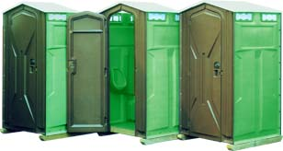
7. Lighting a cigarette in a methane gas filled Port-o-Potty can cause an explosion
A. Confirmed
B. Busted

Slide 17
7. Lighting a cigarette in a methane gas filled Port-o-Potty can cause an explosion
A. Confirmed
B. Busted

Slide 18
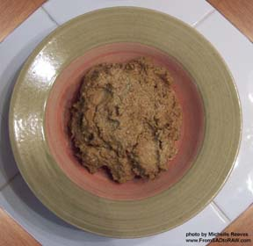
8. Beans and carbonated drinks can cause flatulence
A. Confirmed
B. Busted

Slide 19
8. Beans and carbonated drinks can cause flatulence
A. Confirmed
B. Busted

Slide 20
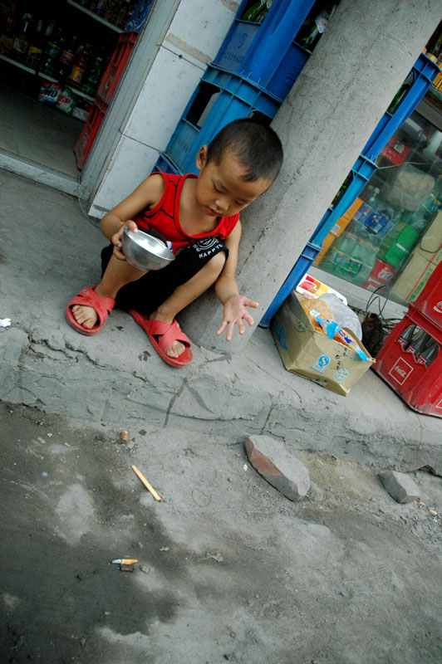
9. If picked up within 5 seconds, food dropped on the floor is still clean
A. Confirmed
B. Busted

Slide 21
9. If picked up within 5 seconds, food dropped on the floor is still clean
A. Confirmed
B. Busted

Slide 22
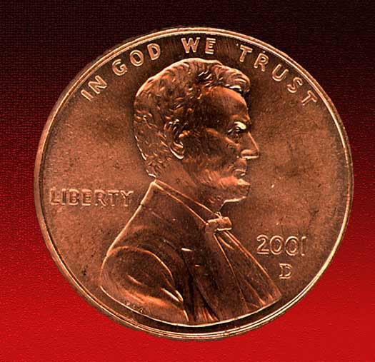
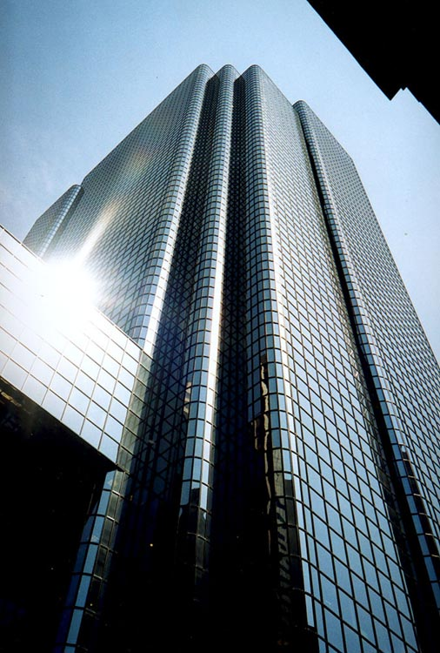
10. A penny dropped from a skyscraper can kill a pedestrian below
A. Confirmed
B. Busted

Slide 23
10. A penny dropped from a skyscraper can kill a pedestrian below
A. Confirmed
B. Busted

Slide 24
TIE BREAKER…

Slide 25
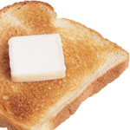
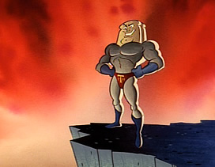
BONUS:
Toast always lands buttered side down when dropped
A. Confirmed
B. Busted

Slide 26
BONUS:
Toast always lands buttered side down when dropped
A. Confirmed
B. Busted

Slide 27
WHERE ARE
YOU SEEKING FULFILLMENT?

Slide 28

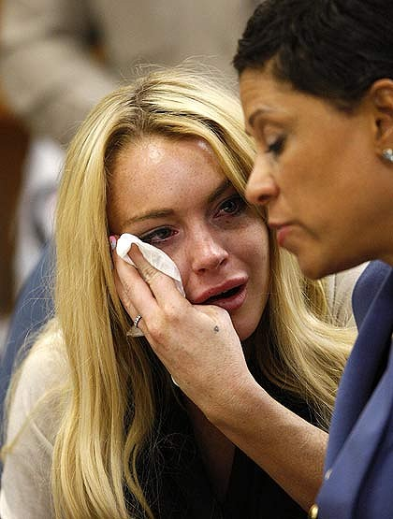







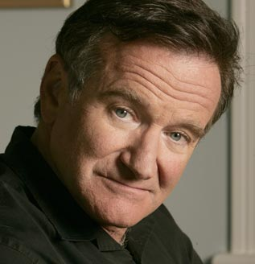



Slide 29
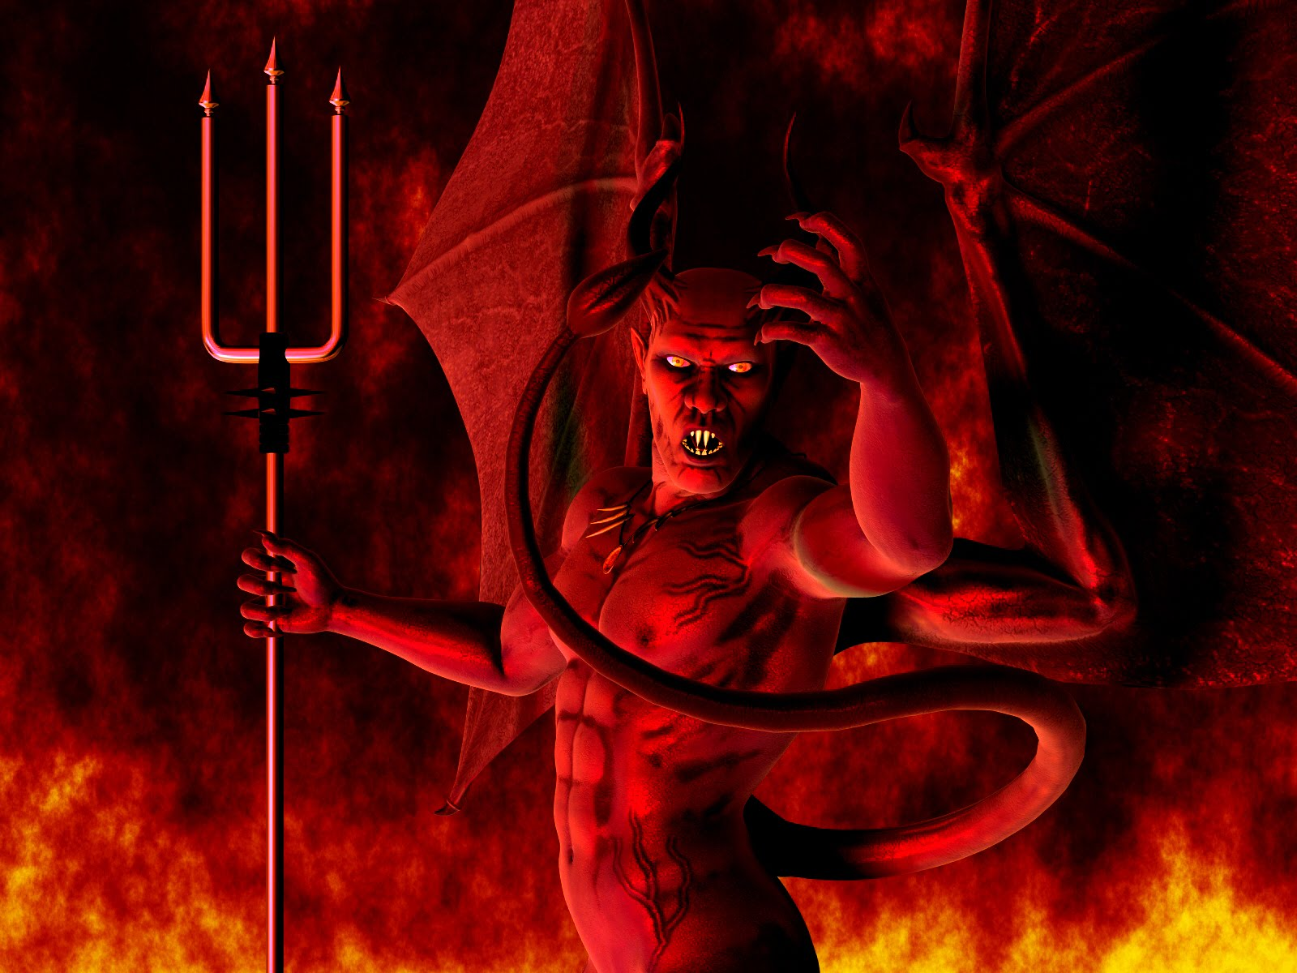

Slide 30

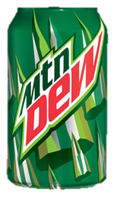


Slide 31
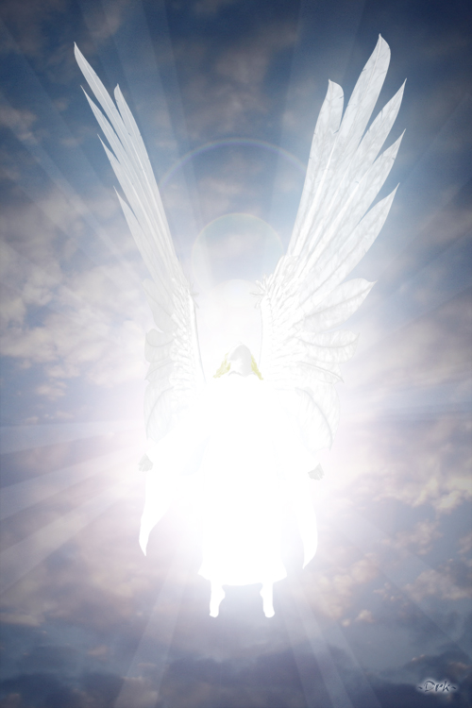
Even Satan disguises himself as an angel of light.
2 Cor. 11:14

Slide 32
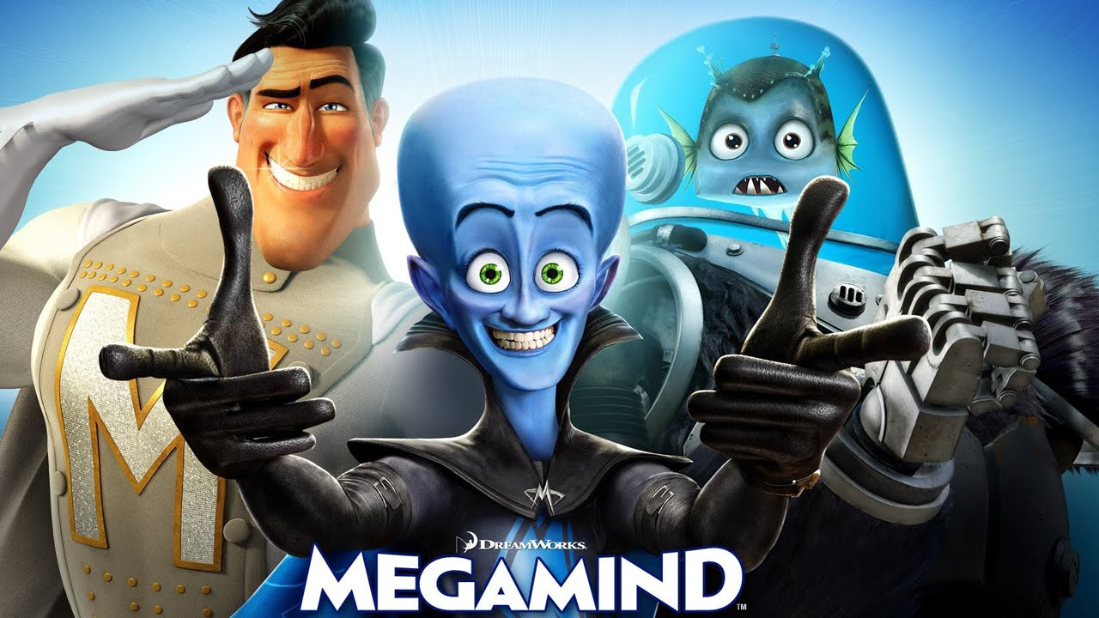

Slide 33


Slide 34
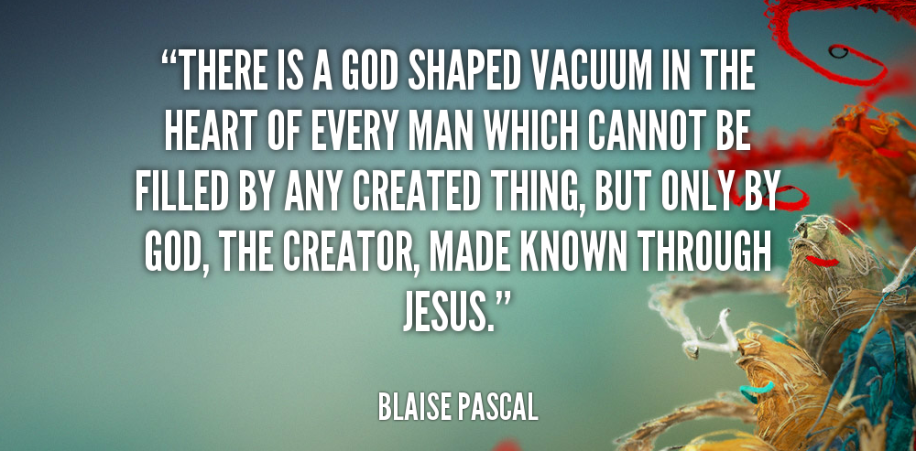

Slide 35


Slide 36
For everyone has sinned; we all fall short of God’s glorious standard. ~ Romans 3:23

Slide 37
For the wages of sin is death, but the free gift of God is eternal life through Christ Jesus our Lord.
~ Romans 6:23

Slide 38
There was a man named Nicodemus, a Jewish religious leader who was a Pharisee. After dark one evening, he came to speak with Jesus. “Rabbi,” he said, “we all know that God has sent you to teach us. Your miraculous signs are evidence that God is with you.”
Jesus replied, “I tell you the truth, unless you are born again,you cannot see the Kingdom of God.”
~ JOHN 3:1-3

Slide 39
Jesus told him, “I am the way, the truth, and the life. No one can come to the Father except through me.”
~ John 14:6

Slide 40
So where are you in your relationship with Jesus?
Is He where you run to for satisfaction and fullness, or are you looking in all the wrong places?

