Slide 2
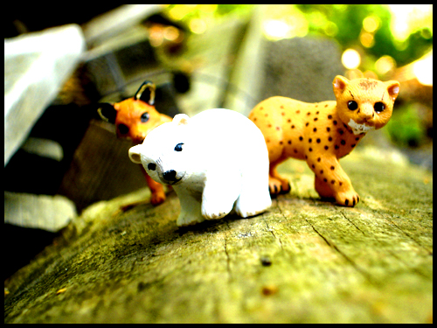
Three One
in
The Animal Morphing Game

Slide 3
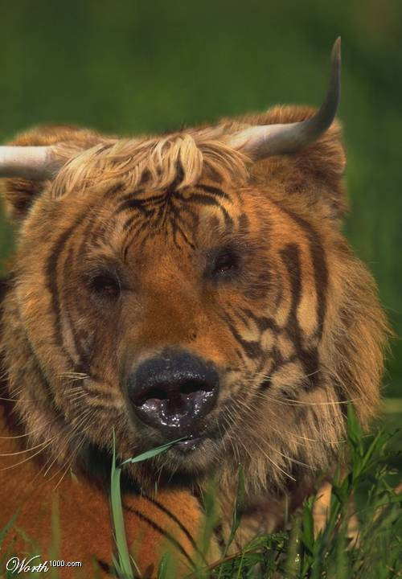
1
Bull
Bear
Tiger

Slide 4
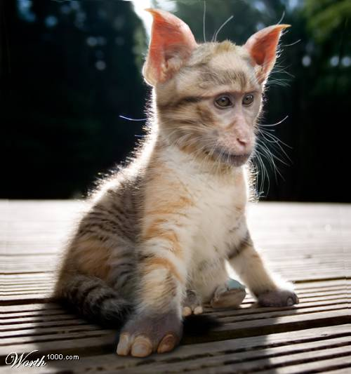
2
Cat, Monkey, Elephant

Slide 5
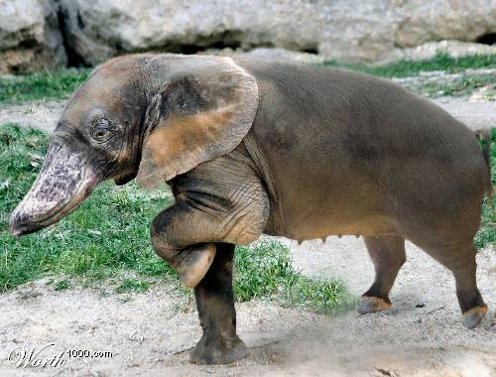
3
Duck
Elephant
Pig

Slide 6
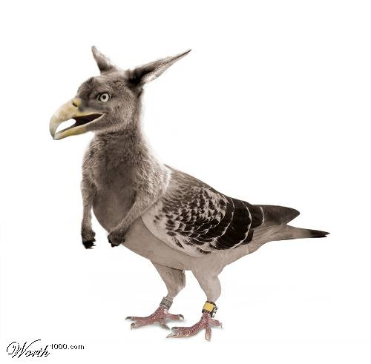
4
Pigeon
Kangaroo
Eagle

Slide 7
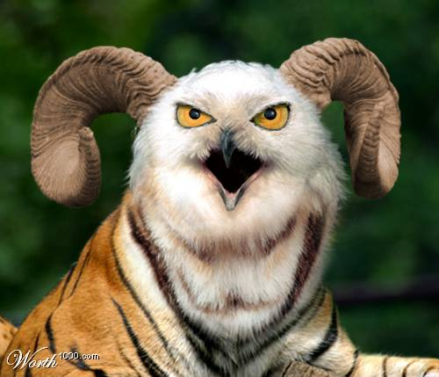
5
Ram
Owl
Tiger

Slide 8
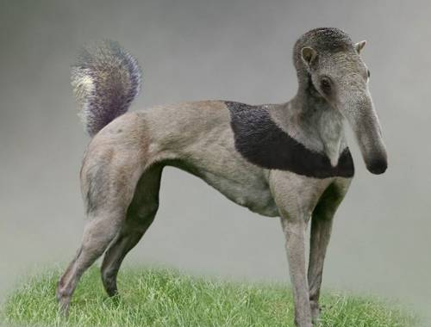
6
Dog
Squirrel
Anteater

Slide 9
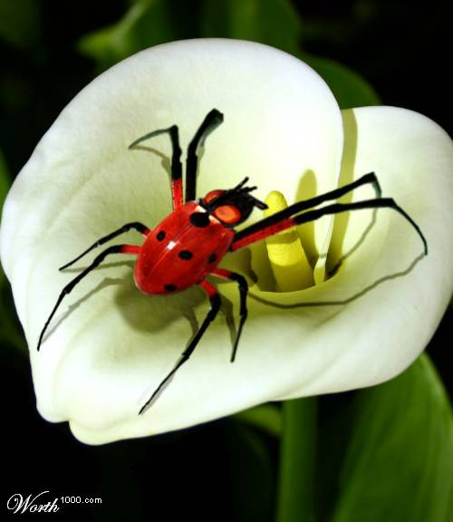
7
Spider
Ladybug
Fly

Slide 10
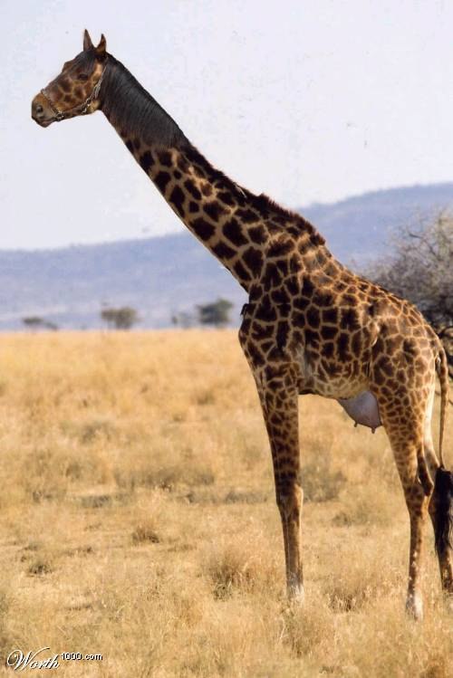
8
Horse
Giraffe
Cow

Slide 11
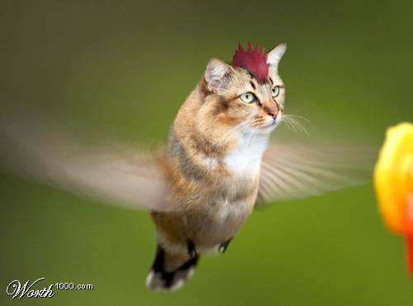
9
Cat
Rooster
Hummingbird

Slide 12
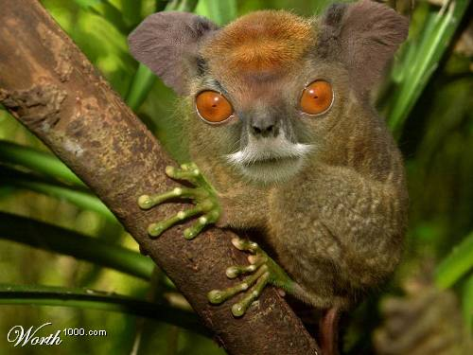
10
Frog
Monkey
Elephant

Slide 13
FOUR ONE
in
BONUS

Slide 14
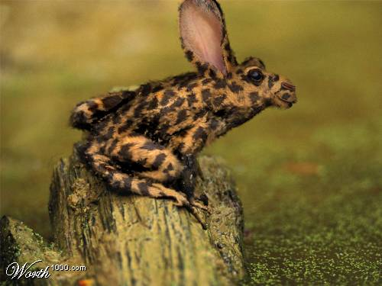
B
Camel
Frog
Rabbit
Leopard

Slide 15
B
L I
N D S
P O T S

Slide 17
SIN

Slide 18
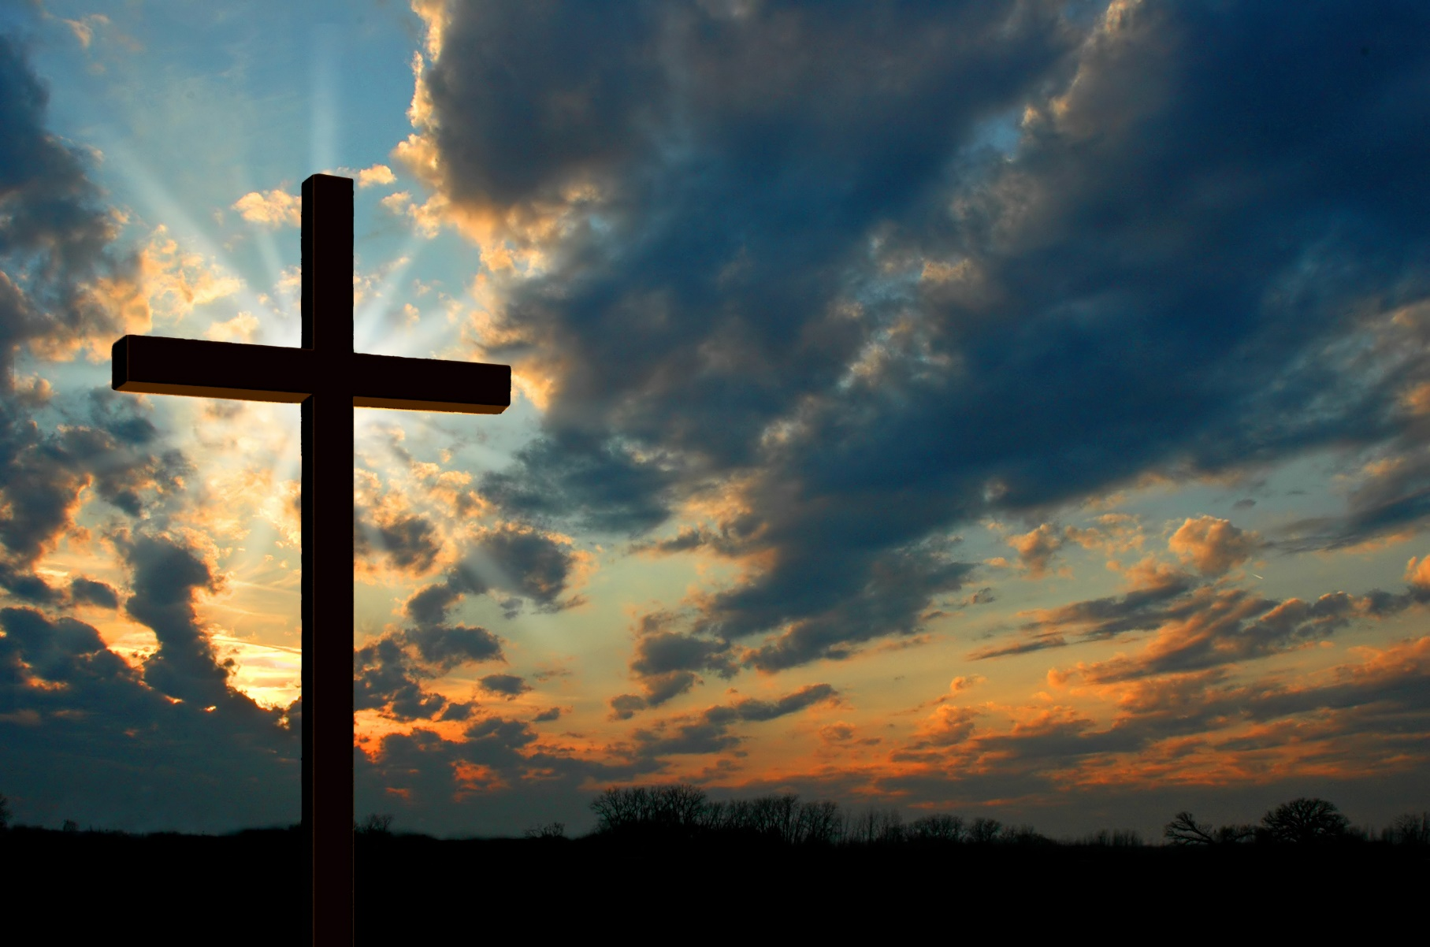

Slide 19
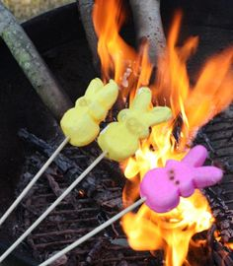
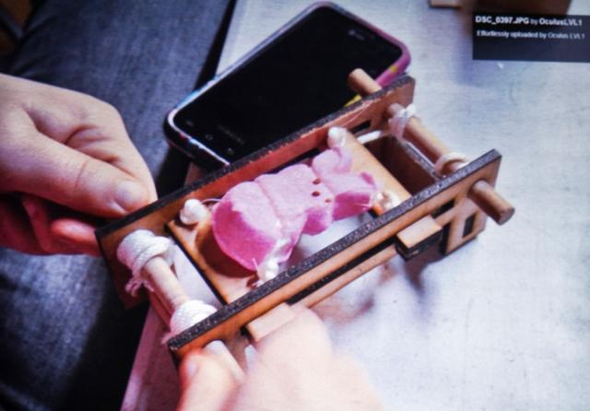

Slide 20
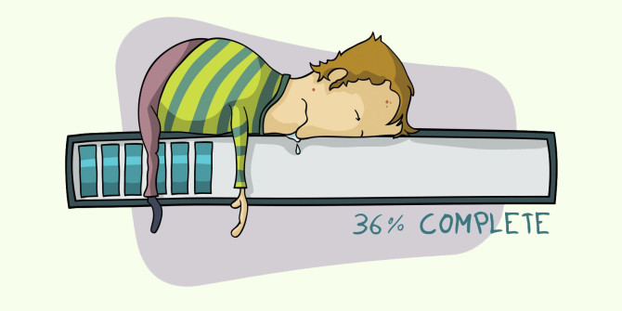

Slide 21
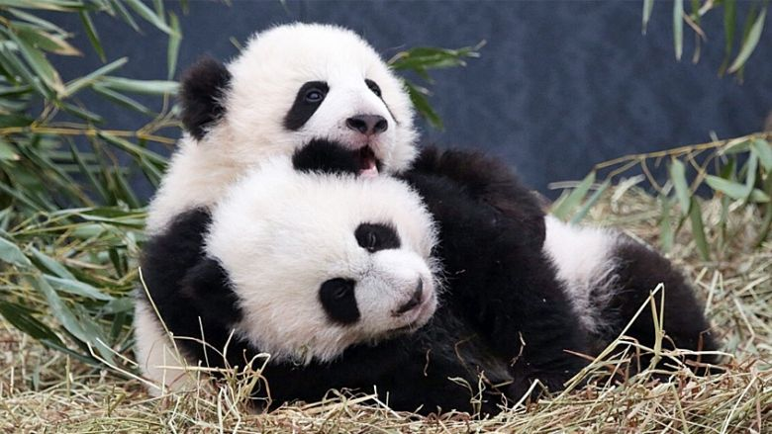

Slide 22
HATE
=
DETESTIBLE EMNITY

Slide 23
PROVERBS 6:16-19
There are six things the Lord hates—no, seven things he detests: haughty eyes, a lying tongue, hands that kill the innocent, a heart that plots evil, feet that race to do wrong, a false witness who pours out lies, a person who sows discord in a family.

Slide 24
JEREMIAH 44:4
“Again and again I sent my servants, the prophets, to plead with them, ‘Don’t do these horrible things that I hate so much.’”

Slide 25
GALATIANS 6:7-8
Don’t be misled—you cannot mock the justice of God. You will always harvest what you plant. Those who live only to satisfy their own sinful nature will harvest decay and death from that sinful nature. But those who live to please the Spirit will harvest everlasting life from the Spirit.

Slide 27
Matthew 27:46
“My God, my God, why have you forsaken me?”

Slide 28
1 CORINTHIANS 15:34
think carefully about what is right, and stop sinning. For to your shame I say that some of you don’t know God at all.

Slide 29
1 JOHN 3:4-6
Everyone who sins is breaking God’s law, for all sin is contrary to the law of God. And you know that Jesus came to take away our sins, and there is no sin in him. Anyone who continues to live in him will not sin. But anyone who keeps on sinning does not know him or understand who he is.

Slide 30
ColOSSIANS 3:5-8
put to death the sinful, earthly things lurking within you. Have nothing to do with sexual immorality, impurity, lust, and evil desires. Don’t be greedy, for a greedy person is an idolater, worshiping the things of this world.

Slide 31
ColOSSIANS 3:5-8
Because of these sins, the anger of God is coming. You used to do these things when your life was still part of this world. But now is the time to get rid of anger, rage, malicious behavior, slander, and dirty language.

Slide 32
PUT TO DEATH
=
KILL OR SLAY

Slide 33
How many things must God hate in something before
we should rip ourselves away?

Slide 34
John 14:23-24
“All who love me will do what I say. My Father will love them, and we will come and make our home with each of them. Anyone who doesn’t love me will not obey me.”

Slide 35
