Slide 51
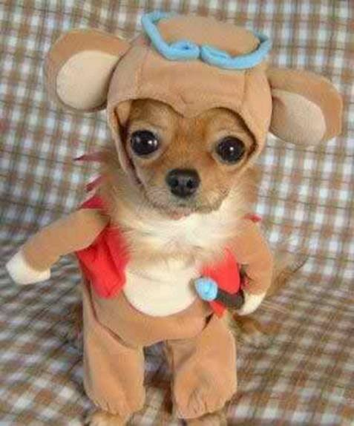

Slide 53
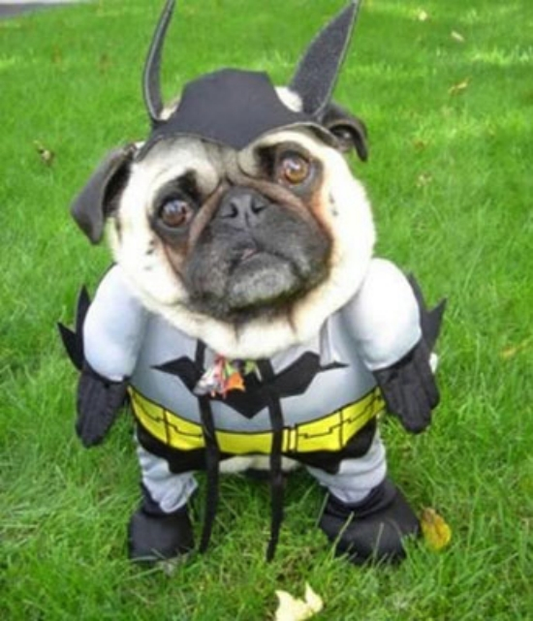

Slide 54
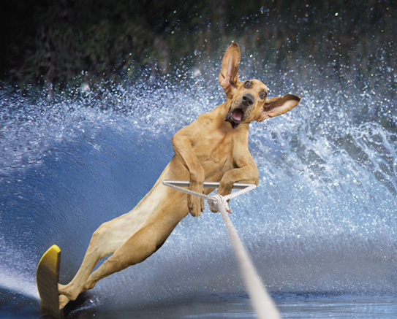

Slide 56
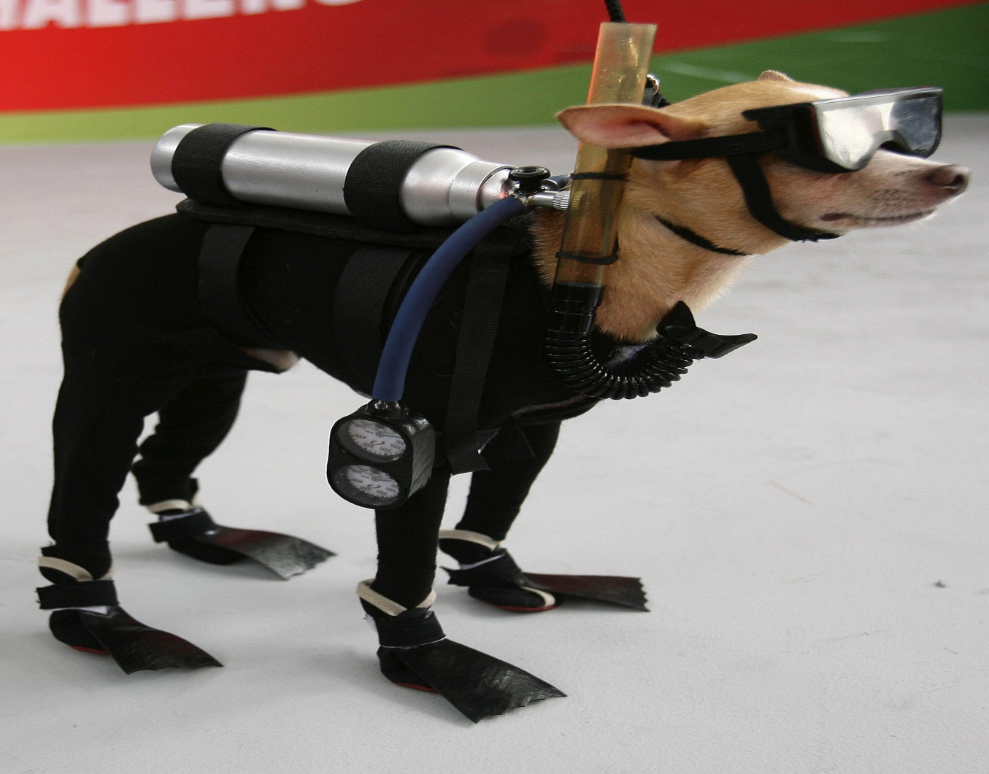

Slide 59
Jesus wants followers who measure themselves against Him and don’t simply try to act “Christian.”

Slide 60
SIX
DIAGNOSING
QUESTIONS

Slide 61
Then he said to them all: “If anyone would come after me, he must deny himself and take up his cross daily and follow me.” ~ Luke 9:23

Slide 62
ALL
COME AFTER

Slide 63
Then he said to them all: “If anyone would come after me, he must deny himself and take up his cross daily and follow me.” ~ Luke 9:23

Slide 65
If you are NOT denying yourself and picking up your cross, then you are probably NOT a follower of Christ.
You are a fan.

Slide 67
Jesus wants you to follow
WHEREVER He goes,
WHENEVER He goes,
To do WHATEVER
He says.

Slide 69
WHEREVER

Slide 70
A fan waits to hear where and then decides.
A follower says “YES” first and then hears where
he or she is going.

Slide 71
WHENEVER

Slide 72
A fan will always be ready to follow Jesus tomorrow.
A follower is ready to drop everything right now.

Slide 73
WHATEVER

Slide 74
A fan is willing to make Jesus a priority in life.
A follower is ready to make Jesus the only priority.

Slide 75
