Slide 17
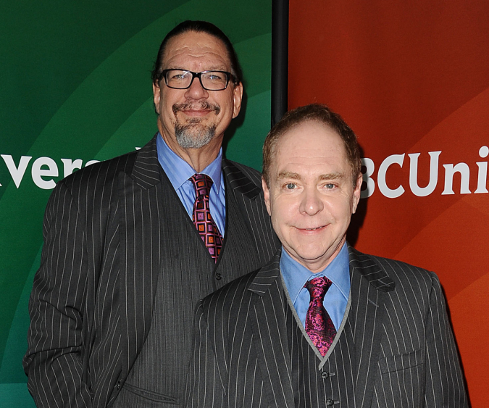
Uh-Oh! Name Them Both

Slide 18
PENN AND TELLER

Slide 28
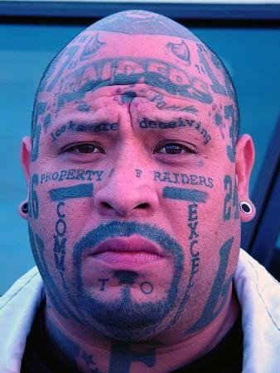

Slide 29
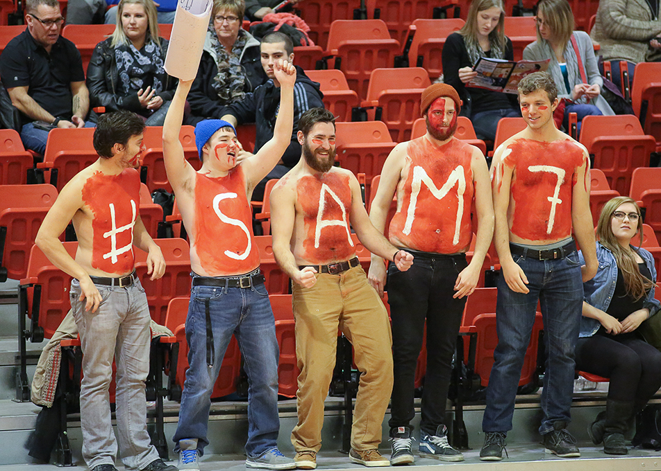

Slide 32
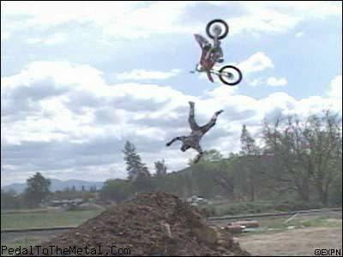

Slide 33
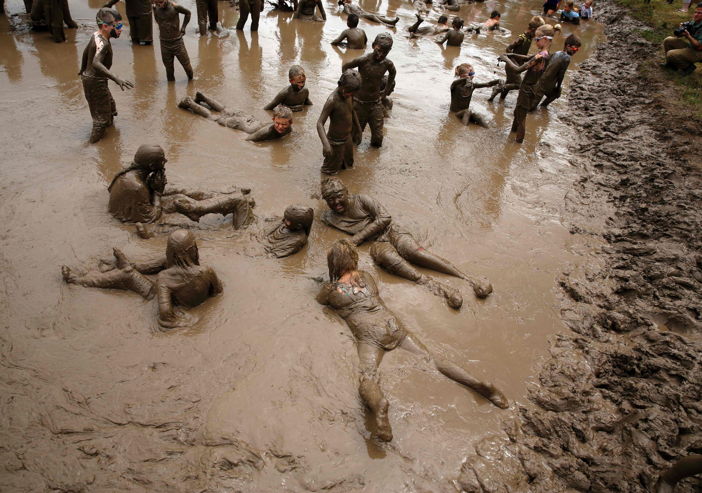

Slide 34
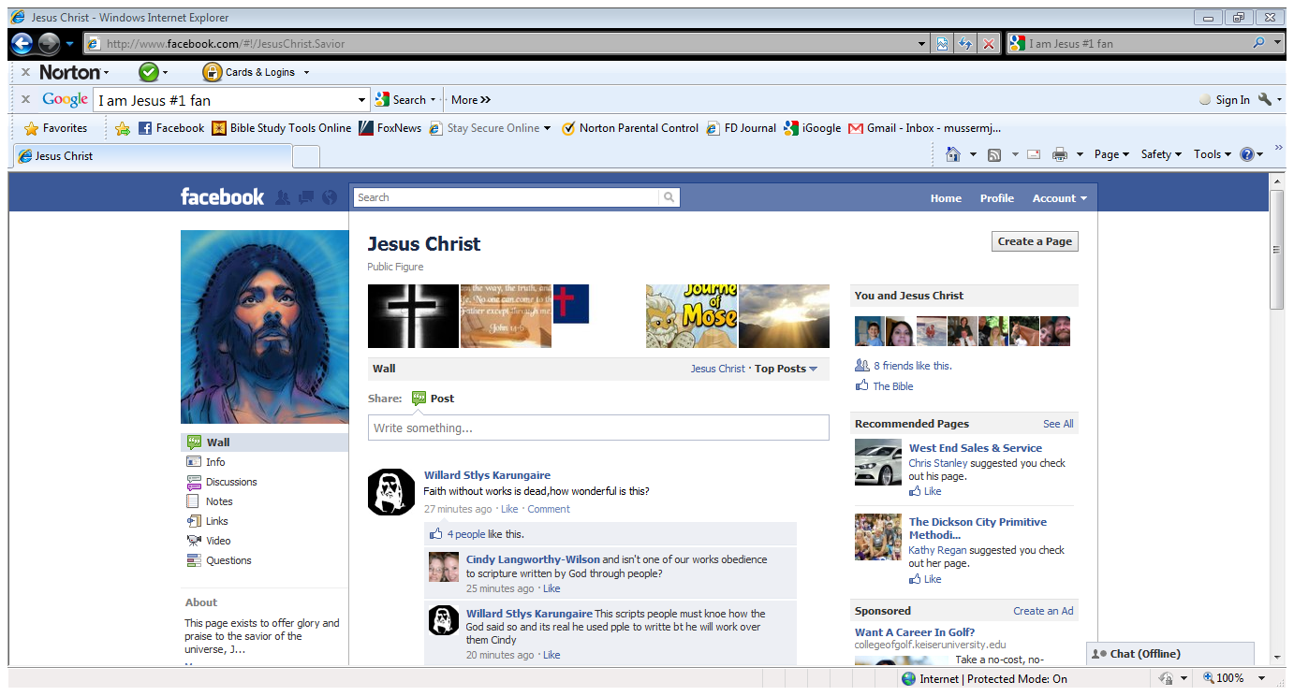

Slide 35
DOES JESUS WANT FANS OR
FOLLOWERS?

Slide 36
Fans want to be part of the crowd

Slide 37
Followers
are willing to stand alone

Slide 38
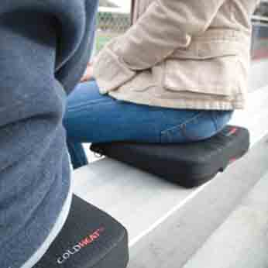
Fans want things to be comfortable and easy

Slide 39
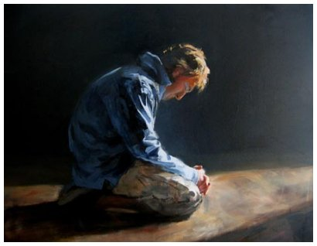
Followers will surrender happiness and sacrifice comfort for Christ

Slide 40
HOW DO YOU MEASURE WHETHER YOU ARE A FAN OR
A FOLLOWER?

Slide 41
MEASUREMENT # 1
Measuring yourself by
looking at others

Slide 42
But they are only comparing with each other and measuring themselves by themselves. What foolishness!
~ 2 Corinthians 10:12

Slide 43
MEASUREMENT # 2
Measuring yourself by
how Christian you
look and act

Slide 44
“These people honor Me with their lips, but their hearts are far away. Their worship is a farce, for they replace God's commands with their own
man-made teachings.”
~ Matthew 15:8,9

Slide 45
MEASUREMENT # 3
Measuring yourself
by Christ’s Standard

Slide 46
"If any of you wants to be my follower, you must put aside your selfish ambition, shoulder your cross daily, and follow me. If you try to keep your life for yourself, you will lose it.

Slide 47
“But if you give up your life for me, you will find true life. And how do you benefit if you gain the whole world but lose or forfeit your own soul in the process?” ~ Luke 9:23-25

