Slide 2
Name That Fear

Slide 3
1. Verbophobia
Fear of vermin
Fear of words
Fear of verbs
Fear of Walloons

Slide 4
2. Metathesiophobia
Fear of cooking
Fear of ants
Fear of changes
Fear of haircuts

Slide 5
3. Ablutophobia
Fear of washing or bathing
Fear of children
Fear of abundance
Fear of waiting

Slide 6
4. Homilophobia
Fear of humans
Fear of homeless people
Fear of sermons
Fear of homonyms

Slide 7
5. Hexakosioihexekontahexaphobia
Fear of hexagons
Fear of numbers
Fear of shapes
Fear of the number 666

Slide 8
6. Hippopotomonstrosesquippedaliophobia
Fear of hippopotamus’s
Fear of long words
Fear of hip hop music
Fear of otters

Slide 9
7. Coulrophobia
Fear of color
Fear of computers
Fear of horse races
Fear of clowns

Slide 10
8. Numerophobia
Fear of the dark
Fear of shellfish
Fear of numbers
Fear of dark wooded areas or of forests at night

Slide 11
9. Phronemophobia
Fear of thinking
Fear of progress
Fear of work
Fear of drugs

Slide 12
10. Zoophobia
Fear of zoo’s
Fear of zoologists
Fear of animals
Fear of mammals

Slide 13
Bonus

Slide 14
Aurophobia
Fear of airplanes
Fear of gold
Fear of the wind
Fear of garlic

Slide 18
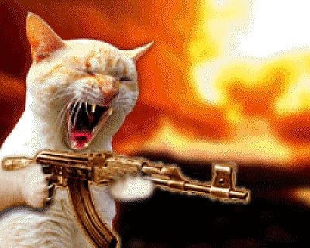

Slide 20
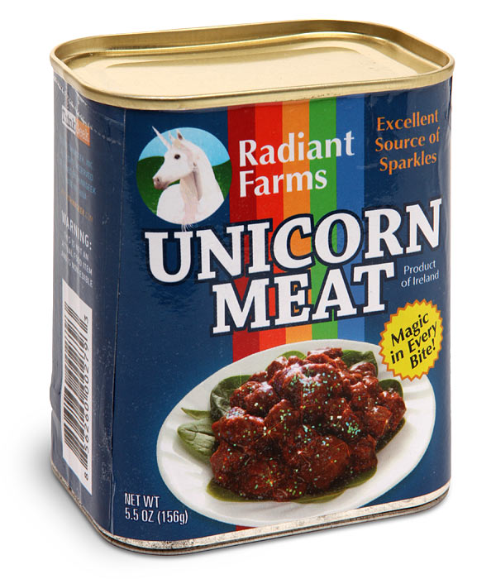

Slide 21
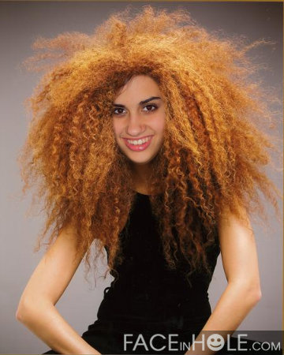

Slide 22
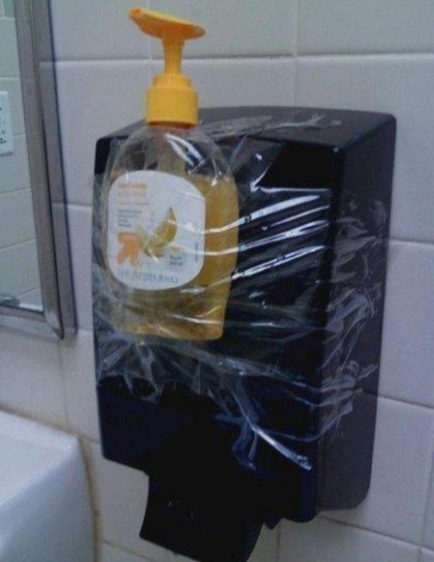
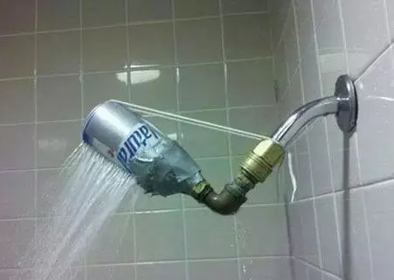

Slide 24
DOES JESUS WANT
FANS OR
FOLLOWERS?

Slide 25
Jesus wants followers who measure themselves against Him and don’t simply try to act “Christian.”

Slide 26
DIAGNOSING FANDOM
QUESTION #1
Have you made a decision for Jesus, or have you committed to Jesus?

Slide 27
DIAGNOSING FANDOM
QUESTION #2
Do you just know about Jesus, or do you really know Him?

Slide 28
DIAGNOSING FANDOM
QUESTION #3
Is Jesus one of many, or
is He your one and only?

Slide 29
DIAGNOSING FANDOM
QUESTION #4
Are you more focused
on the outside
than the inside?

Slide 30
DIAGNOSING FANDOM
QUESTION #5
Are you a
self-empowered fan
or a Spirit-filled follower?

Slide 31
DIAGNOSING FANDOM
QUESTION #6
Does your life
reflect what you say
you believe about Jesus?

Slide 33
“It’s not that fans don’t want to have a relationship with Jesus, they just want one on their own terms. The question is, though, what kind of relationship does Jesus want to have with us?”

Slide 34
Then he said to them all: “If anyone would come after me, he must deny himself and take up his cross daily and follow me.” ~ Luke 9:23

Slide 35
ALL/ANYONE
~ Not just grown adults
~ Not just pastors
~ Not just missionaries
Jesus calls EVERYONE

Slide 36
ALL/ANYONE
~ Not just the “perfect” ones
~ Not just those who “have it
all together”
~ Not just those who only sin
“a little”

Slide 37
Then he said to them all: "If anyone would come after me, he must deny himself and take up his cross daily and follow me.” ~ Luke 9:23

Slide 38
COME AFTER
=
“Passionate pursuit”

Slide 39
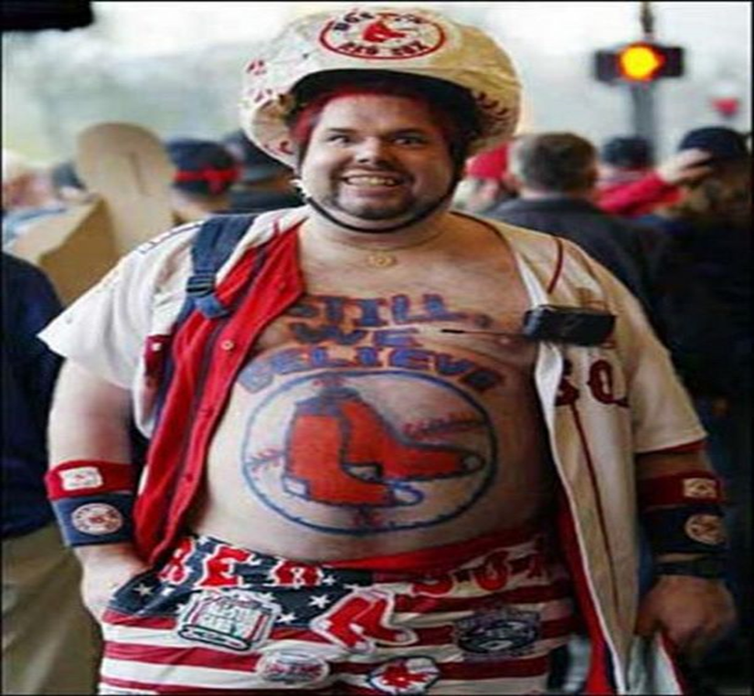
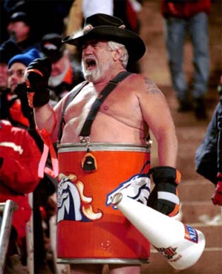

Slide 40
“The Kingdom of Heaven is like
a treasure that a man discovered hidden in a field. In his excitement, he hid it again and sold everything he owned to get enough money
to buy the field.” ~ Matthew 13:44

Slide 41
Do you have stories about
your pursuit of Jesus
that make people
say, “That’s crazy”?

