Slide 2
Bumper Stumper

Slide 3
RUNVS

Slide 4
R U Envious

Slide 5
BU10NOO

Slide 6
Button Nose

Slide 7
ICULOOKN

Slide 8
I C U Looking

Slide 9
10SNE1

Slide 10
Tennis Anyone?

Slide 11
IH8WRK

Slide 12
I Hate Work

Slide 13
2M8OS

Slide 14
TOMATOES

Slide 15
B4DKCME

Slide 16
B 4 Decay C Me

Slide 17
AGR8PL8

Slide 18
A Great Plate

Slide 19
HNYBNY

Slide 20
Honey Bunny

Slide 21
CRE8IV

Slide 22
Creative

Slide 23
BONUS

Slide 24
1DR4L

Slide 25
WONDERFUL

Slide 26
B
L I
N D S
P O T S

Slide 27
SIN

Slide 28
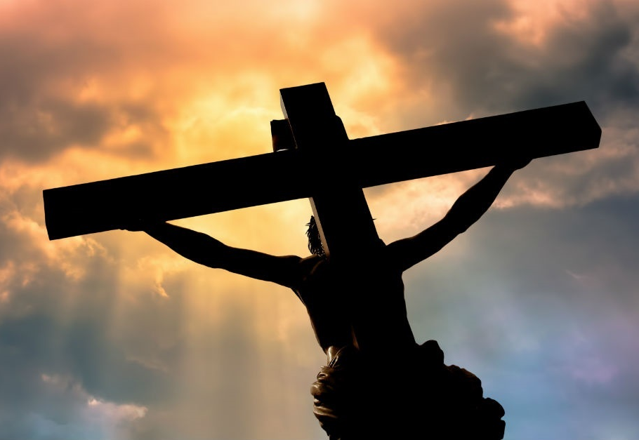

Slide 29
GOSSIP
AND THE
POWER OF WORDS

Slide 30
PROVERBS 18:21
Life and death are in the power of the tongue, and those who love it will eat its fruits.

Slide 31
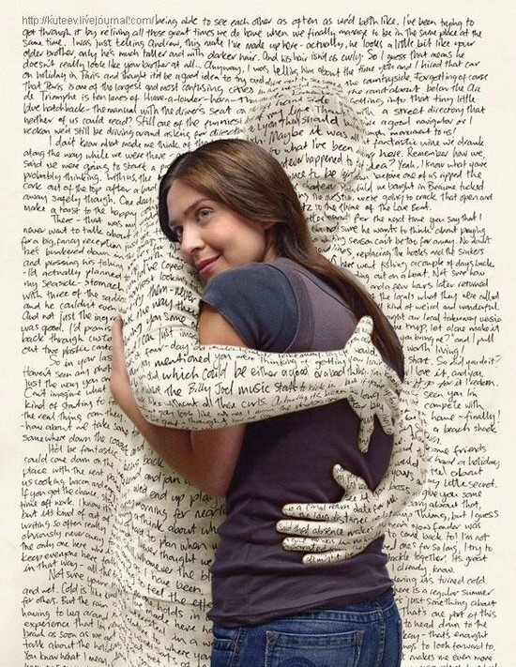
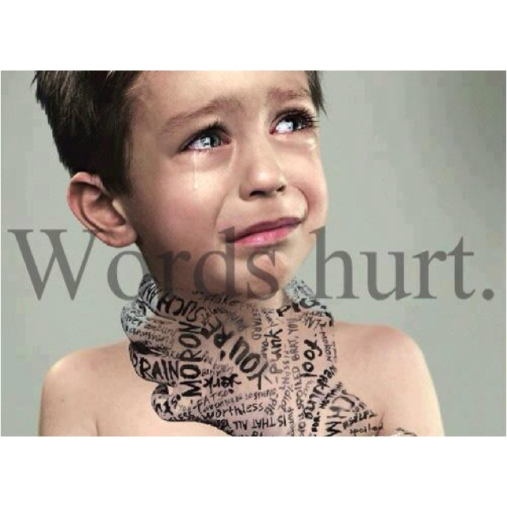

Slide 32
PROVERBS 15:4
Gentle words bring life and health…

Slide 33
ENTERTAINMENT STANDARDS

Slide 34
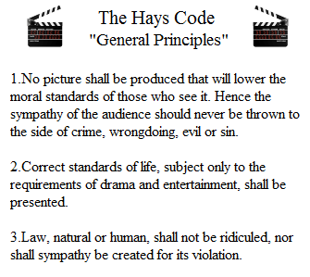
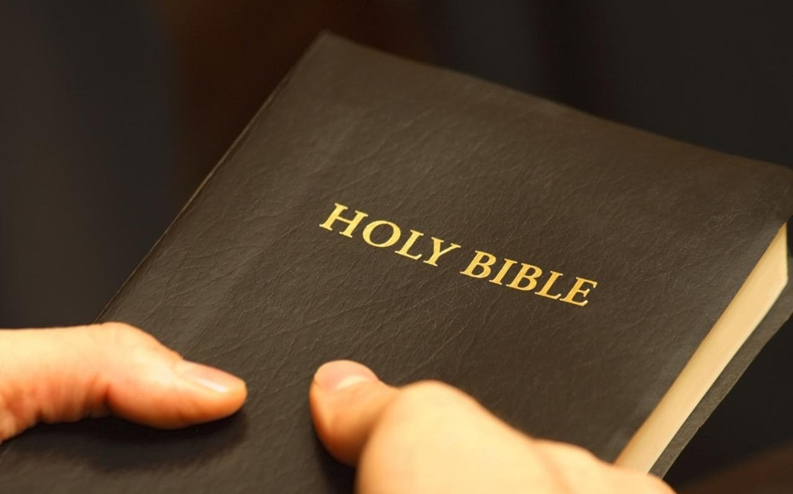

Slide 35
SEXUALITY
PROFANITY
BLASPHEMY
Violence
TIME

Slide 36
PORN

Slide 37
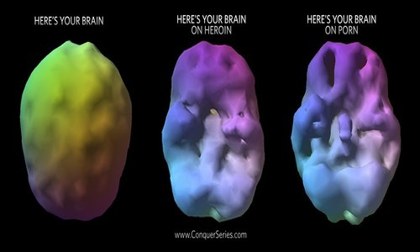
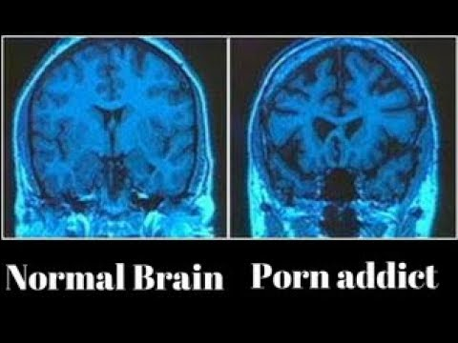

Slide 38
1 Corinthians 6:18
Run from sexual sin! No other sin so clearly affects the body as this one does. For sexual immorality is a sin against your own body.

Slide 39
hell

Slide 40
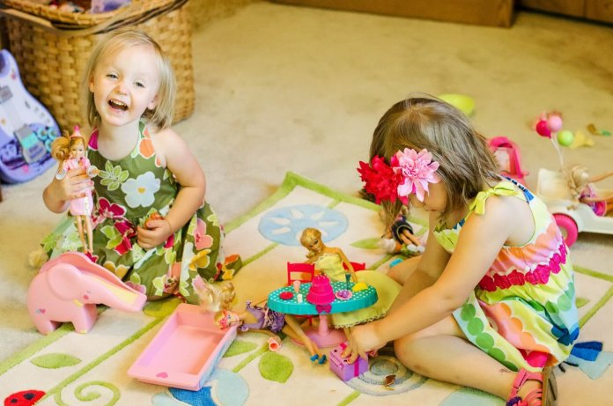

Slide 41
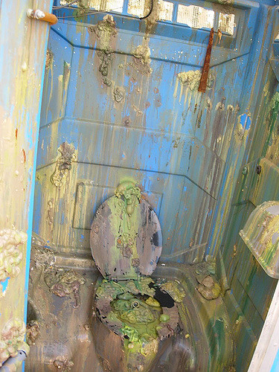

Slide 42
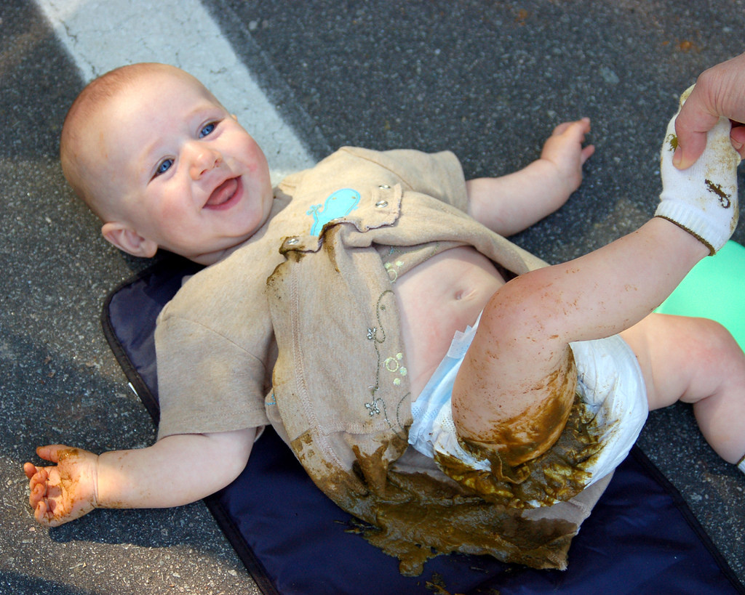

Slide 44
hell

Slide 45
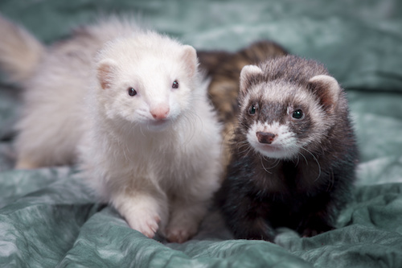

Slide 46
Every day over 153,000 people die around the world.
close to 6,400 every hour.
or nearly 107 a minute
Just about 2 people every second

Slide 48
Matthew 5:22
“But I say, if you are even angry with someone, you are subject to judgment! If you call someone an idiot, you are in danger of being brought before the court. And if you curse someone, you are in danger of the fires of hell.”

Slide 49
Matthew 5:29
“If your eye—even your good eye—causes you to lust, gouge it out and throw it away. It is better for you to lose one part of your body than for your whole body to be thrown into hell.”

Slide 50
Matthew 7:13
“You can enter God’s Kingdom only through the narrow gate. The highway to hell is broad, and its gate is wide for the many who choose that way.”

Slide 51
Matthew 10:28
“Don’t be afraid of those who want to kill your body; they cannot touch your soul. Fear only God, who can destroy both soul and body in hell.”

Slide 52
Matthew 13:49-50
“That is the way it will be at the end of the world. The angels will come and separate the wicked people from the righteous, throwing the wicked into the fiery furnace, where there will be weeping and gnashing of teeth.”

Slide 53
Matthew 25:31-46
“But when the Son of Man comes in His glory, and all the angels with Him, then He will sit upon His glorious throne. All the nations will be gathered in His presence, and He will separate them as a shepherd separates the sheep from the goats.”

Slide 54
Matthew 25:31-46
“He will place the sheep at His right hand and the goats at His left. Then the King will say to those on the right, 'Come, you who are blessed by my Father, inherit the Kingdom prepared for you from the foundation of the

Slide 55
Matthew 25:31-46
world’…Then the King will turn to those on the left and say, 'Away with you, you cursed ones, into the eternal fire prepared for the Devil and his demons!’ ...And they will go away into eternal punishment, but the righteous will go into eternal life.”

Slide 56
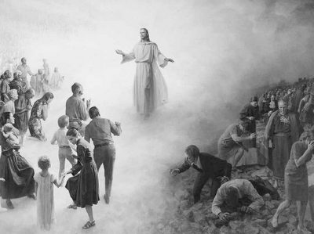

Slide 57
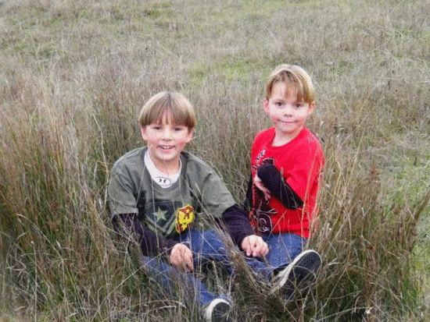

Slide 59
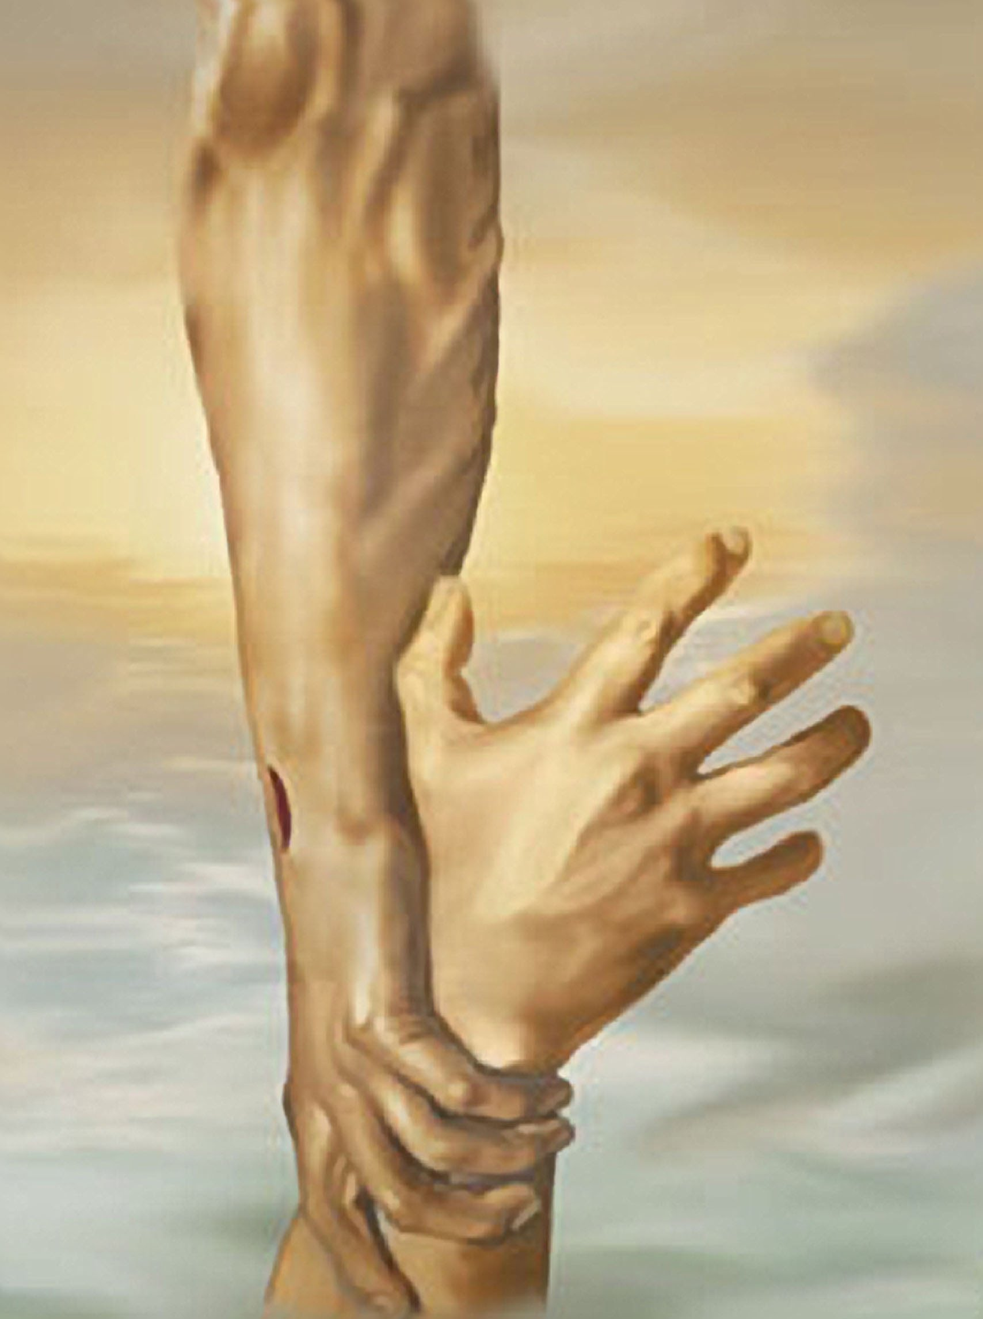

Slide 60
John 3:16
for this is how God loved the world: He gave his one and only Son, so that everyone who believes in him will not perish but have eternal life.

Slide 61
1 john 1:9
if we confess our sins to him, he is faithful and just to forgive us our sins and to cleanse us from all wickedness.

