Slide 2
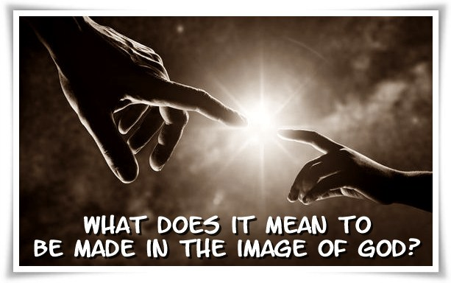

Slide 3
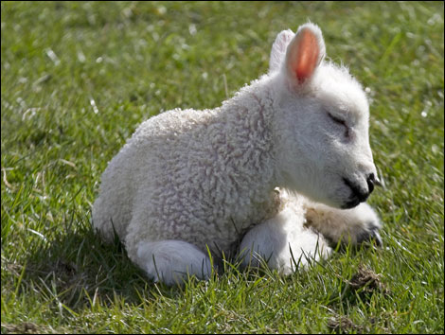

Slide 4
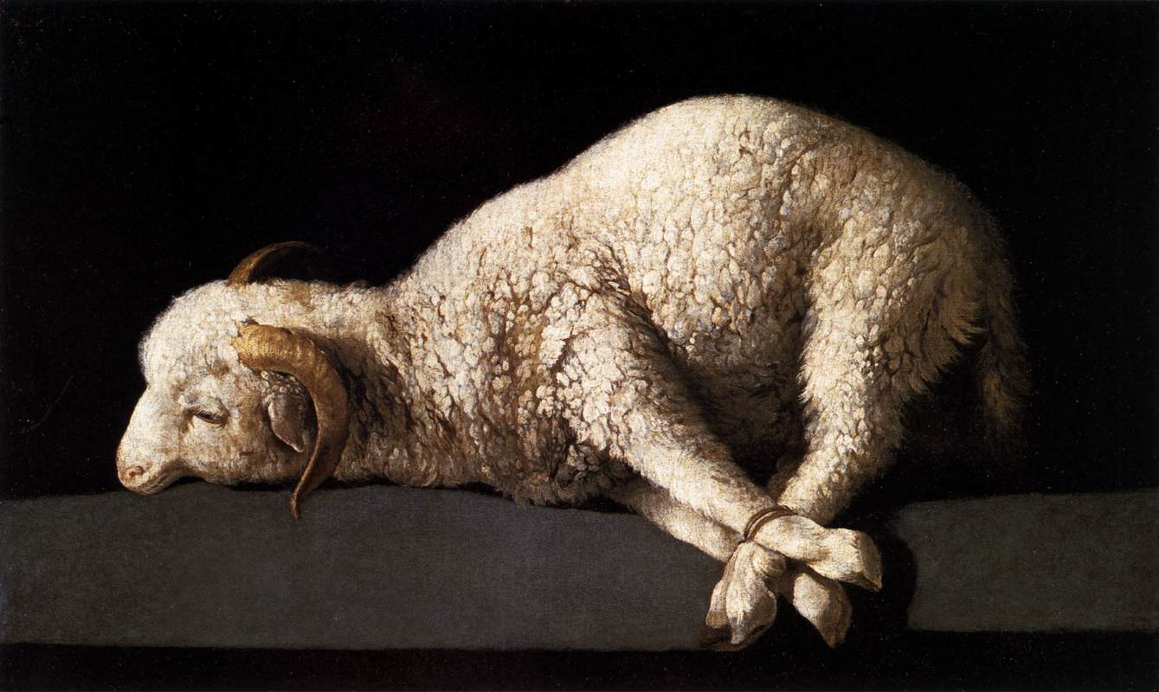

Slide 5
HEBREWS 9:22
In fact, according to the law of Moses, nearly everything was purified with blood. For without the shedding of blood, there is no forgiveness.

Slide 6
ISAIAH 53:6,7
All of us have strayed away like sheep. We have left God's paths to follow our own. Yet the Lord laid on Him the guilt and sins of us all. He was oppressed and treated harshly, yet He never said a word. He was led as a lamb to the slaughter...

Slide 7
JOHN 1:29
The next day John saw Jesus and said, “Look! The Lamb of God who takes away the sin of the world.”

Slide 8
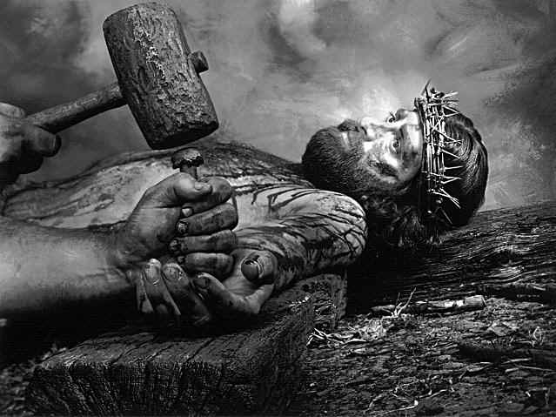

Slide 9
1 PETER 1:18,19
For you know that God paid a ransom to save you from the empty life you inherited from your ancestors. And the ransom He paid was not mere gold or silver. He paid for you with the precious lifeblood of Christ, the sinless, spotless Lamb of God.

Slide 11
1 John 4:10
This is real love. It is not that we loved God, but that he loved us and sent his Son as a sacrifice to take away our sins.

Slide 12
Admit you are a sinner
Believe that Jesus is the Son of God who died for your sins and rose again
Confess that Jesus is your Savior and Lord
Do all that He tells you

