Slide 2
Name That
Carol

Slide 3
Each carol has been reworded. Guess the correct name of each song by replacing the words.

Slide 4
1
Approach, everyone who is steadfast
O Come, All Ye Faithful

Slide 5
2
Ecstasy toward the orb
Joy to the World

Slide 6
3
Hush, the foretelling spirits harmonize
Hark, the Herald Angels Sing

Slide 7
4
Quiescent nocturnal period
Silent Night

Slide 8
5
The primary arrival of God
The First Noel

Slide 9
6
Embellish the pathways
Deck the Halls

Slide 10
7
Fantasy concerning a blanched Yuletide
I’m Dreaming of a White Christmas

Slide 11
8
I apprehend my maternal parent osculating with a corpulent, unshaven male in crimson disguise
I Saw Mommy Kissing Santa Clause

Slide 12
Obese personification fabricated of compressed mounds of minute crystals
9
Frosty the Snowman

Slide 13
10
The thing manifest itself at the onset of a transparent day
It Came Upon a Midnight Clear

Slide 14
B
O
N
U
S
The tatterdemalion ebony atmosphere
O Holy Night

Slide 15
WHAT GOD
WANTS FOR
CHRISTMAS

Slide 21
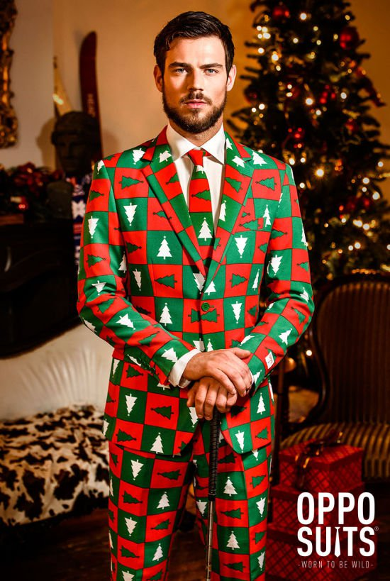

Slide 24
WHAT GOD
WANTS FOR
CHRISTMAS

Slide 25
ROMANS
11:36 – 12:2

Slide 26
GLORY

Slide 27
GLORY
Heavy
Weighty
Magnificent

Slide 28
For everything comes
from him and everything
exists by his power and is
intended for his glory. All
glory to Him forever!
~ Romans 11:36

Slide 29
O God, we give glory to you all day long and constantly praise your name. ~ Psalm 44:8

Slide 30
Do not let any part of your body become an instrument of evil to serve sin. Instead, give yourselves completely to God, for you were dead, but now you have new life. So use your whole body as an instrument to do what is right for the glory of God. ~ Romans 6:13

Slide 31
I plead with you to give your bodies to God because of all he has done for you. Let them be a living and holy sacrifice—the kind he will find acceptable. This is truly the way to worship him. ~ Romans 12:1

Slide 32
Don’t copy the behavior and customs of this world, but let God transform you into a new person by changing the way you think. Then you will learn to know God’s will for you, which is good and pleasing and perfect. ~ Romans 12:2

Slide 33
PEOPLE AROUND YOU
SHOULD KNOW THAT
GOD SHOWED UP
BECAUSE YOU SHOWED UP

Slide 34
VAIN
EMPTY
WEIGHTLESS
NOTHINGNESS
“BREATH/VAPOR”

Slide 35
VAIN
vs.
GLORY

Slide 37
At the name of Jesus,
every knee should bow, in heaven and on earth and under the earth, and
every tongue confess that
Jesus Christ is Lord…

Slide 38
TO THE GLORY
OF GOD
THE FATHER.
~ Philippians 2:10-11

Slide 39
WHAT GOD
WANTS FOR
CHRISTMAS

