Slide 4
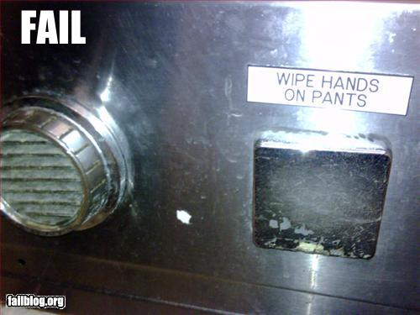

Slide 5
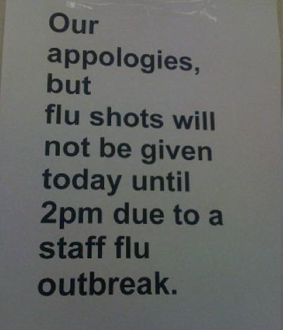

Slide 7
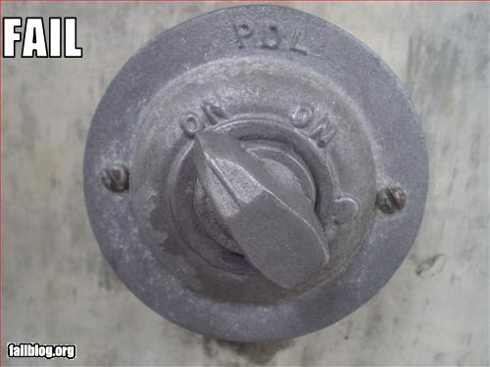

Slide 9
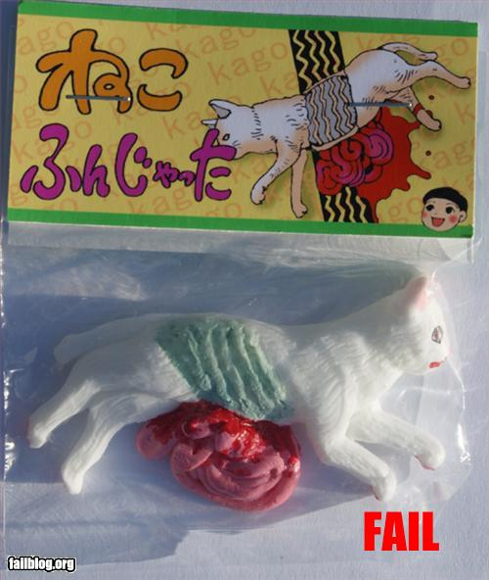

Slide 12
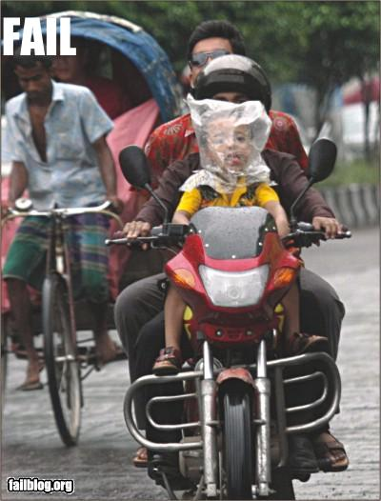

Slide 16
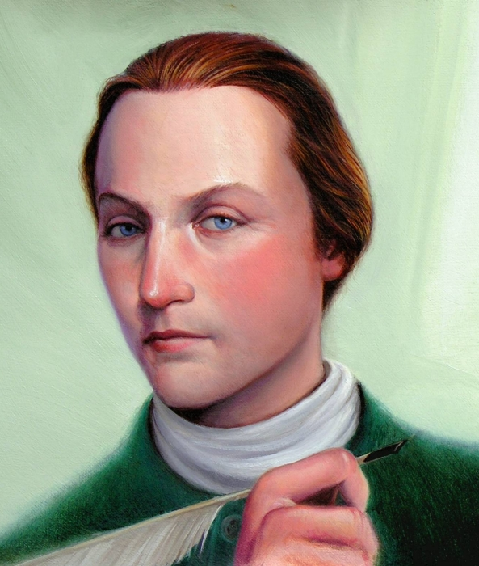
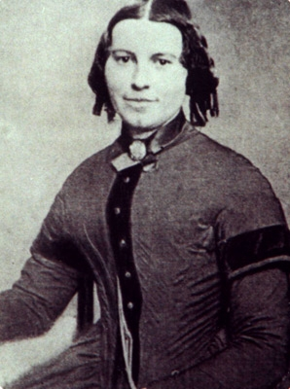
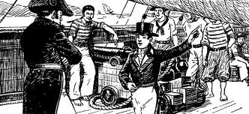

Slide 17
You can be a
contributor
or a consumer

Slide 18
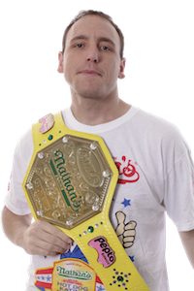
11 time winner of Nathan’s Famous
Hot Dog Eating Contest
Record: 74
in 10 minutes
JOEY CHESTNUT

Slide 19
IN THOSE TEN MINUTES:
150 children died
of starvation
180 children died
from preventable
disease

Slide 20
IN THOSE TEN MINUTES:
20 children were
sold into slavery
1050 people died
70% without Christ
as their Savior

Slide 21
Will you use your time, money, and passions to contribute or to consume???

Slide 22
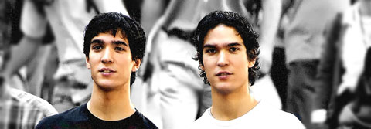
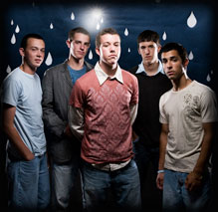

Slide 23
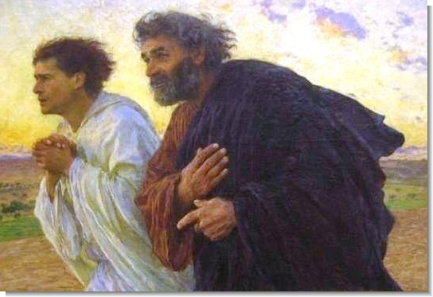
1 Timothy 4:12

Slide 24
Do not let anyone look down on you because you are young. Instead set an example in speech, in life, in love, in faith, and in purity. ~1 Timothy 4:12

Slide 25
FIVE KINDS OF HARD

Slide 26
FIVE KINDS OF HARD
Do things that are _____ your ______ ______
Do things that ____ _____ what is _____ or ______
Ask God to do things you can ___ ___ ____ ___ ___

Slide 27
FIVE KINDS OF HARD
Do things that ____ ____ an
_______ ________
Do things that ______ the ____ ________ that the ______ ______ for you

Slide 28
FIVE KINDS OF HARD
Do things that
are outside your
comfort zone

Slide 29
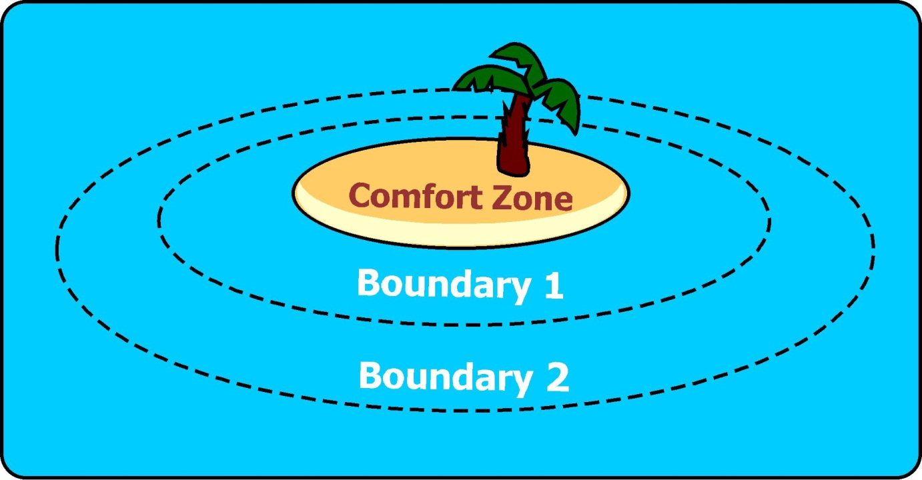

Slide 31
Do things that are
outside your comfort zone
God works through your weaknesses
Courage is not the absence of fear

Slide 32
GRACE MALLY

Slide 33
For God has not given us a spirit of fear and timidity, but of power, love, and self-discipline. ~ 2 Timothy 1:7

Slide 34
FIVE KINDS OF HARD
Do things that go beyond what is
expected or required

Slide 36
When you focus on
“JUST DO YOUR BEST”
you’re just focused on
what you can do, not
the MORE God can do.

Slide 37
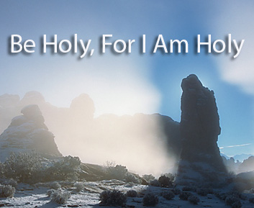
YOU CANNOT RISE UP TO GOD’S
STANDARDS BY DOING YOUR BEST.
IT ONLY HAPPENS WHEN YOU ALLOW
GOD TO ENABLE YOU TO FAR
OUTREACH ANYTHING YOU COULD
EVER DO ON YOUR OWN.

Slide 38
Do not let anyone look down on you because you are young. Instead set an example in speech, in life, in love, in faith, and in purity. ~1 Timothy 4:12

