Slide 28
You can be a
contributor
or a consumer

Slide 29
Will you use your time, money, and passions to contribute or to consume???

Slide 30
Do not let anyone look down on you because you are young. Instead set an example in speech, in life, in love, in faith, and in purity. ~1 Timothy 4:12

Slide 31
FIVE KINDS OF HARD

Slide 32
FIVE KINDS OF HARD
Do things that are _____ your ______ ______
Do things that ____ _____ what is _____ or ______
Ask God to do things you can ___ ___ ____ ___ ___

Slide 33
FIVE KINDS OF HARD
Do things that ____ ____ an
_______ ________
Do things that ______ the ____ ________ that the ______ ______ for you

Slide 34
FIVE KINDS OF HARD
Do things that
are outside your
comfort zone

Slide 35
FIVE KINDS OF HARD
Do things that go beyond what is expected or required

Slide 36
FIVE KINDS OF HARD
Ask God to do things
you can only accomplish with
His help

Slide 37
FIVE KINDS OF HARD
Do things that don’t earn an immediate payoff

Slide 38
FIVE KINDS OF HARD
Do things that challenge the low expectations that the culture sets for you

Slide 39
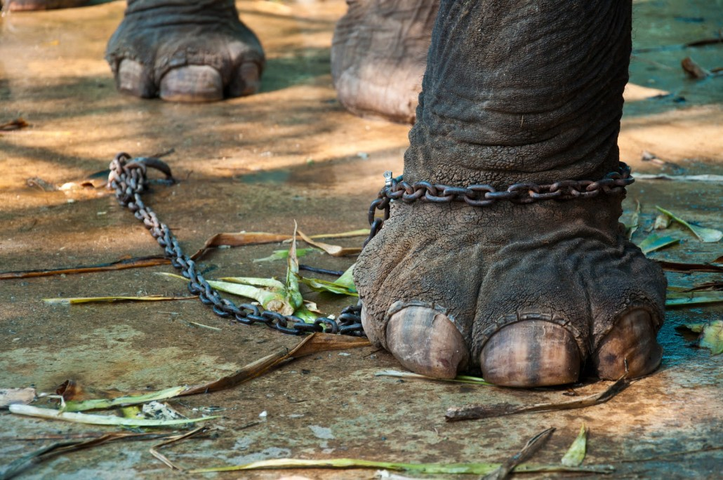

Slide 40
NOAH
BRANDON
SERENA

Slide 41
MAKE A PLAN
TO SUCCEED

