Slide 3
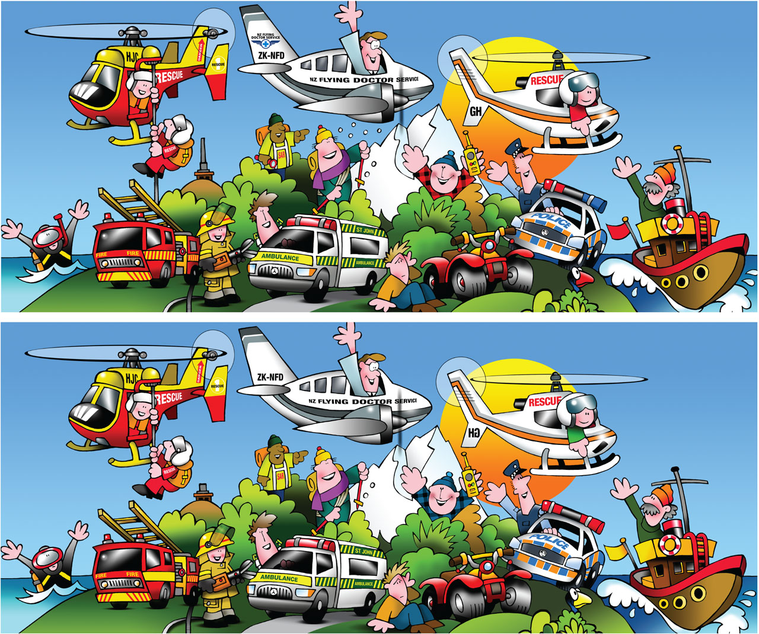

Slide 4
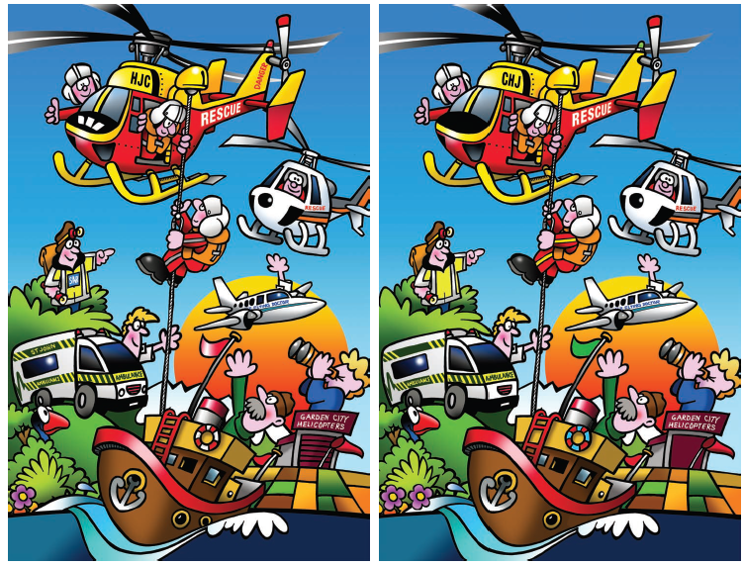

Slide 5
B
L I
N D S
P O T S

Slide 6
SIN

Slide 8
GOSSIP
AND THE
POWER OF WORDS

Slide 9
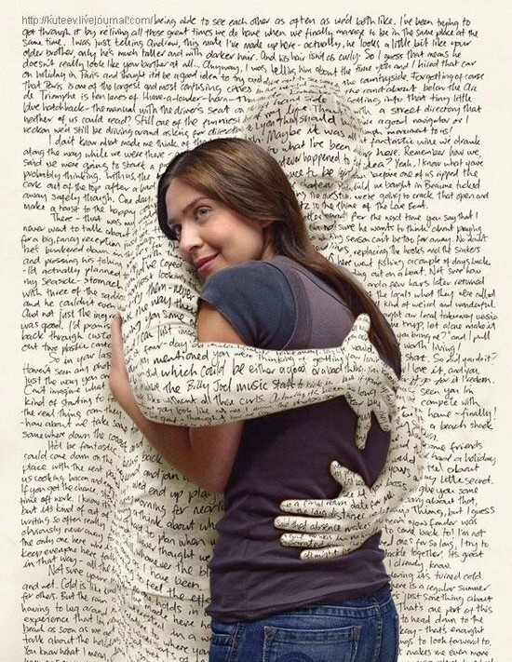
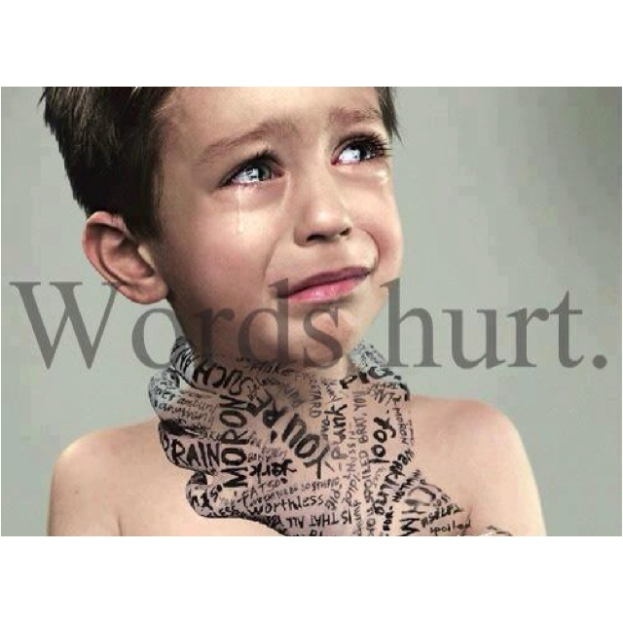

Slide 10
ENTERTAINMENT STANDARDS

Slide 11
SEXUALITY
PROFANITY
BLASPHEMY
Violence
TIME

Slide 12
PORN

Slide 13
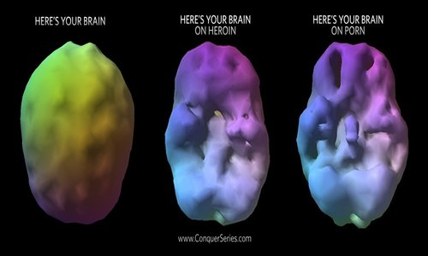
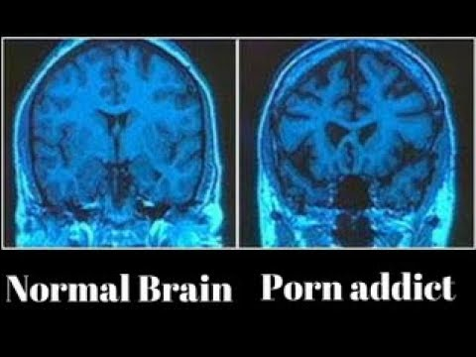

Slide 14
hell

Slide 15
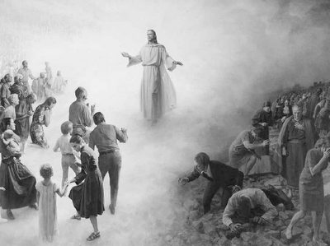

Slide 16
SPIRITUAL BATTLE

Slide 18
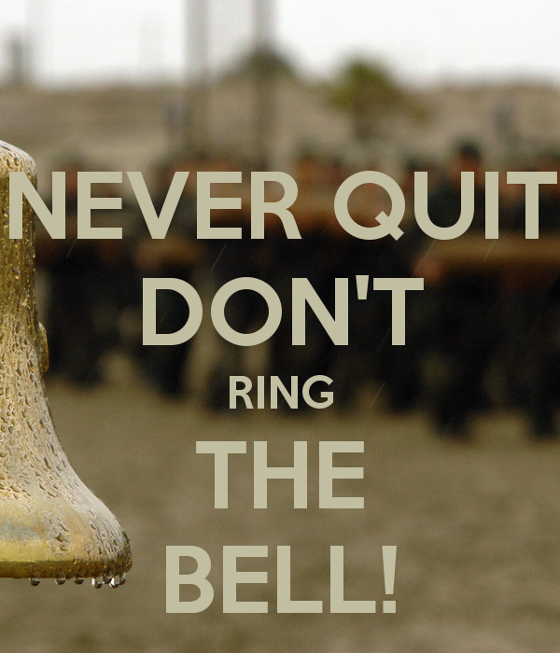

Slide 19
THE NEED
TO
TRANSFORM

Slide 20
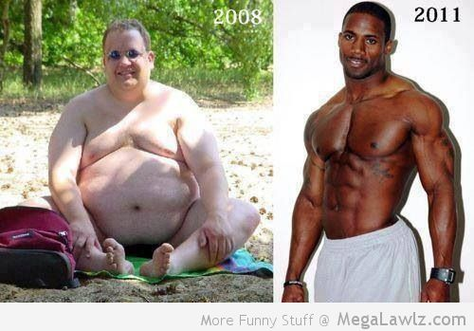

Slide 21
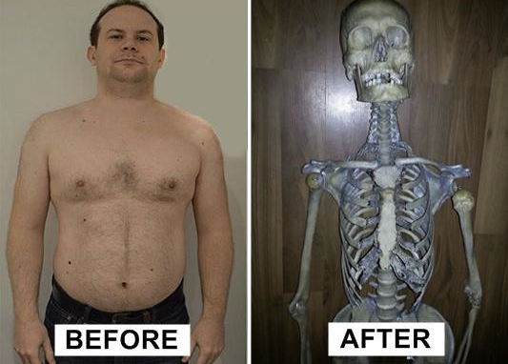

Slide 22
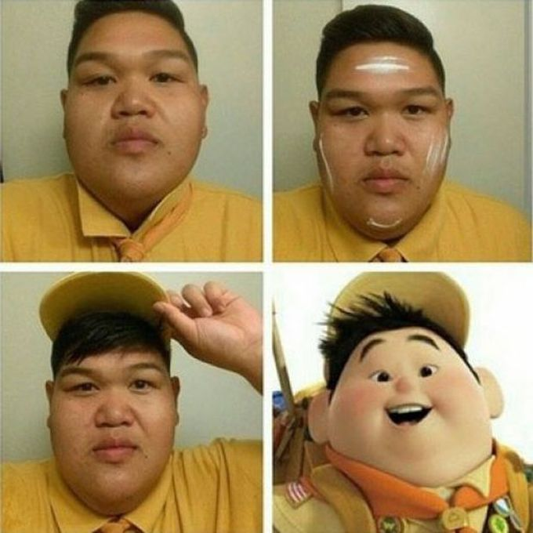

Slide 23
THE NEED
TO
TRANSFORM

Slide 25
“All the habits of the patient, both mental and bodily, are still in our favor.”

Slide 26
Romans 3:23
all have sinned and fallen short of the glory of God.

Slide 27
2 Corinthians 5:15,17
[Jesus] died for everyone so that those who receive his new life will no longer live to please themselves. Instead, they will live to please Christ, who died

Slide 28
2 Corinthians 5:15,17
and was raised for them... What this means is that those who become Christians become new persons. They are not the same anymore, for the old life is gone. A new life has begun!

Slide 30
Colossians 3:7-10
You used to do [sinful deeds] when your life was still part of this world. But now is the time to get rid of anger, rage, malicious behavior, slander, and dirty language. Don't lie to each other, for you have stripped off your old evil nature and all its

Slide 31
Colossians 3:7-10
wicked deeds. In its place you have clothed yourselves with a brand-new nature that is continually being renewed as you learn more and more about Christ, who created this new nature within you.

Slide 35
Work hard to show the results of your salvation, obeying God with deep reverence and fear.
~ Philippians 2:12
Work hard so you can present yourself to God and receive his approval. ~ 2 Timothy 2:15
So, dear brothers and sisters, work hard to prove that you really are among those God has called and chosen. ~ 1 Peter 1:10

Slide 37
Hebrews 5:12-14
you have been believers so long now that you ought to be teaching others. Instead, you need someone to teach you again the basic things about God’s word. You are like babies who need milk and cannot eat solid

Slide 38
Hebrews 5:12-14
food. For someone who lives on milk is still an infant and doesn’t know how to do what is right. Solid food is for those who are mature, who through training have the skill to recognize the difference between right and wrong.

