Slide 2
What Movie is This Line From?

Slide 3
“It’s just like riding
a bike, except you crap on it.”

Slide 4
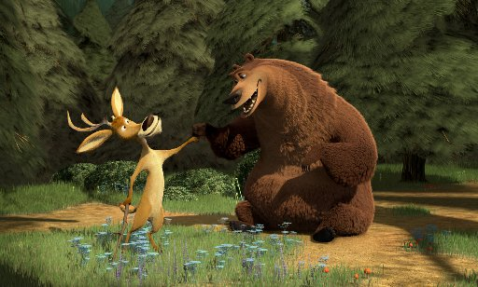
OPEN SEASON

Slide 5
“In my world, everyone is a pony and they all eat rainbows-and poop butterflies! “

Slide 6
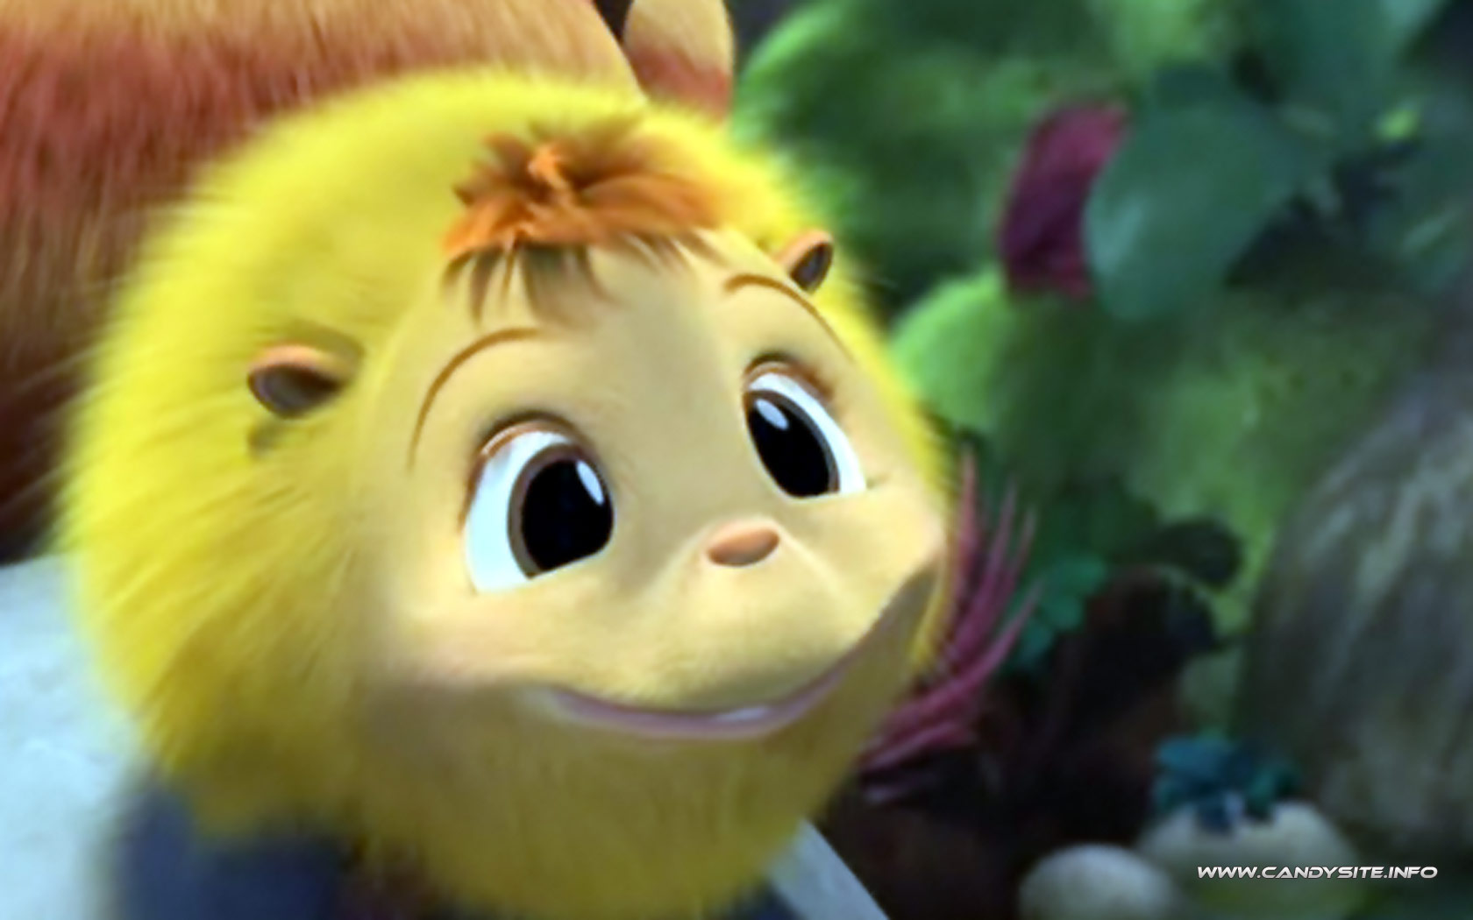
HORTON HEARS A WHO

Slide 7
“Man, you gotta warn somebody before you just crack one off. My mouth was open and everything!”

Slide 8
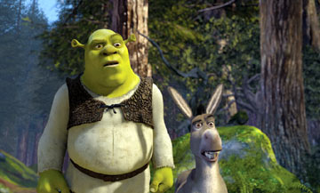
SHREK

Slide 9
“You will not cry, or sneeze, or barf, or fart! No annoying sounds.”

Slide 10
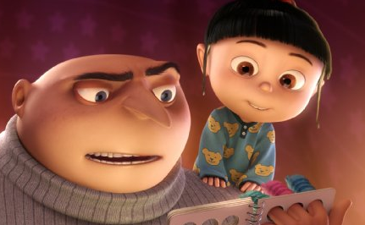
DESPICABLE ME

Slide 11
“He was so deadly, in fact, that his enemies would go blind from over-exposure to pure awesomeness!”

Slide 12
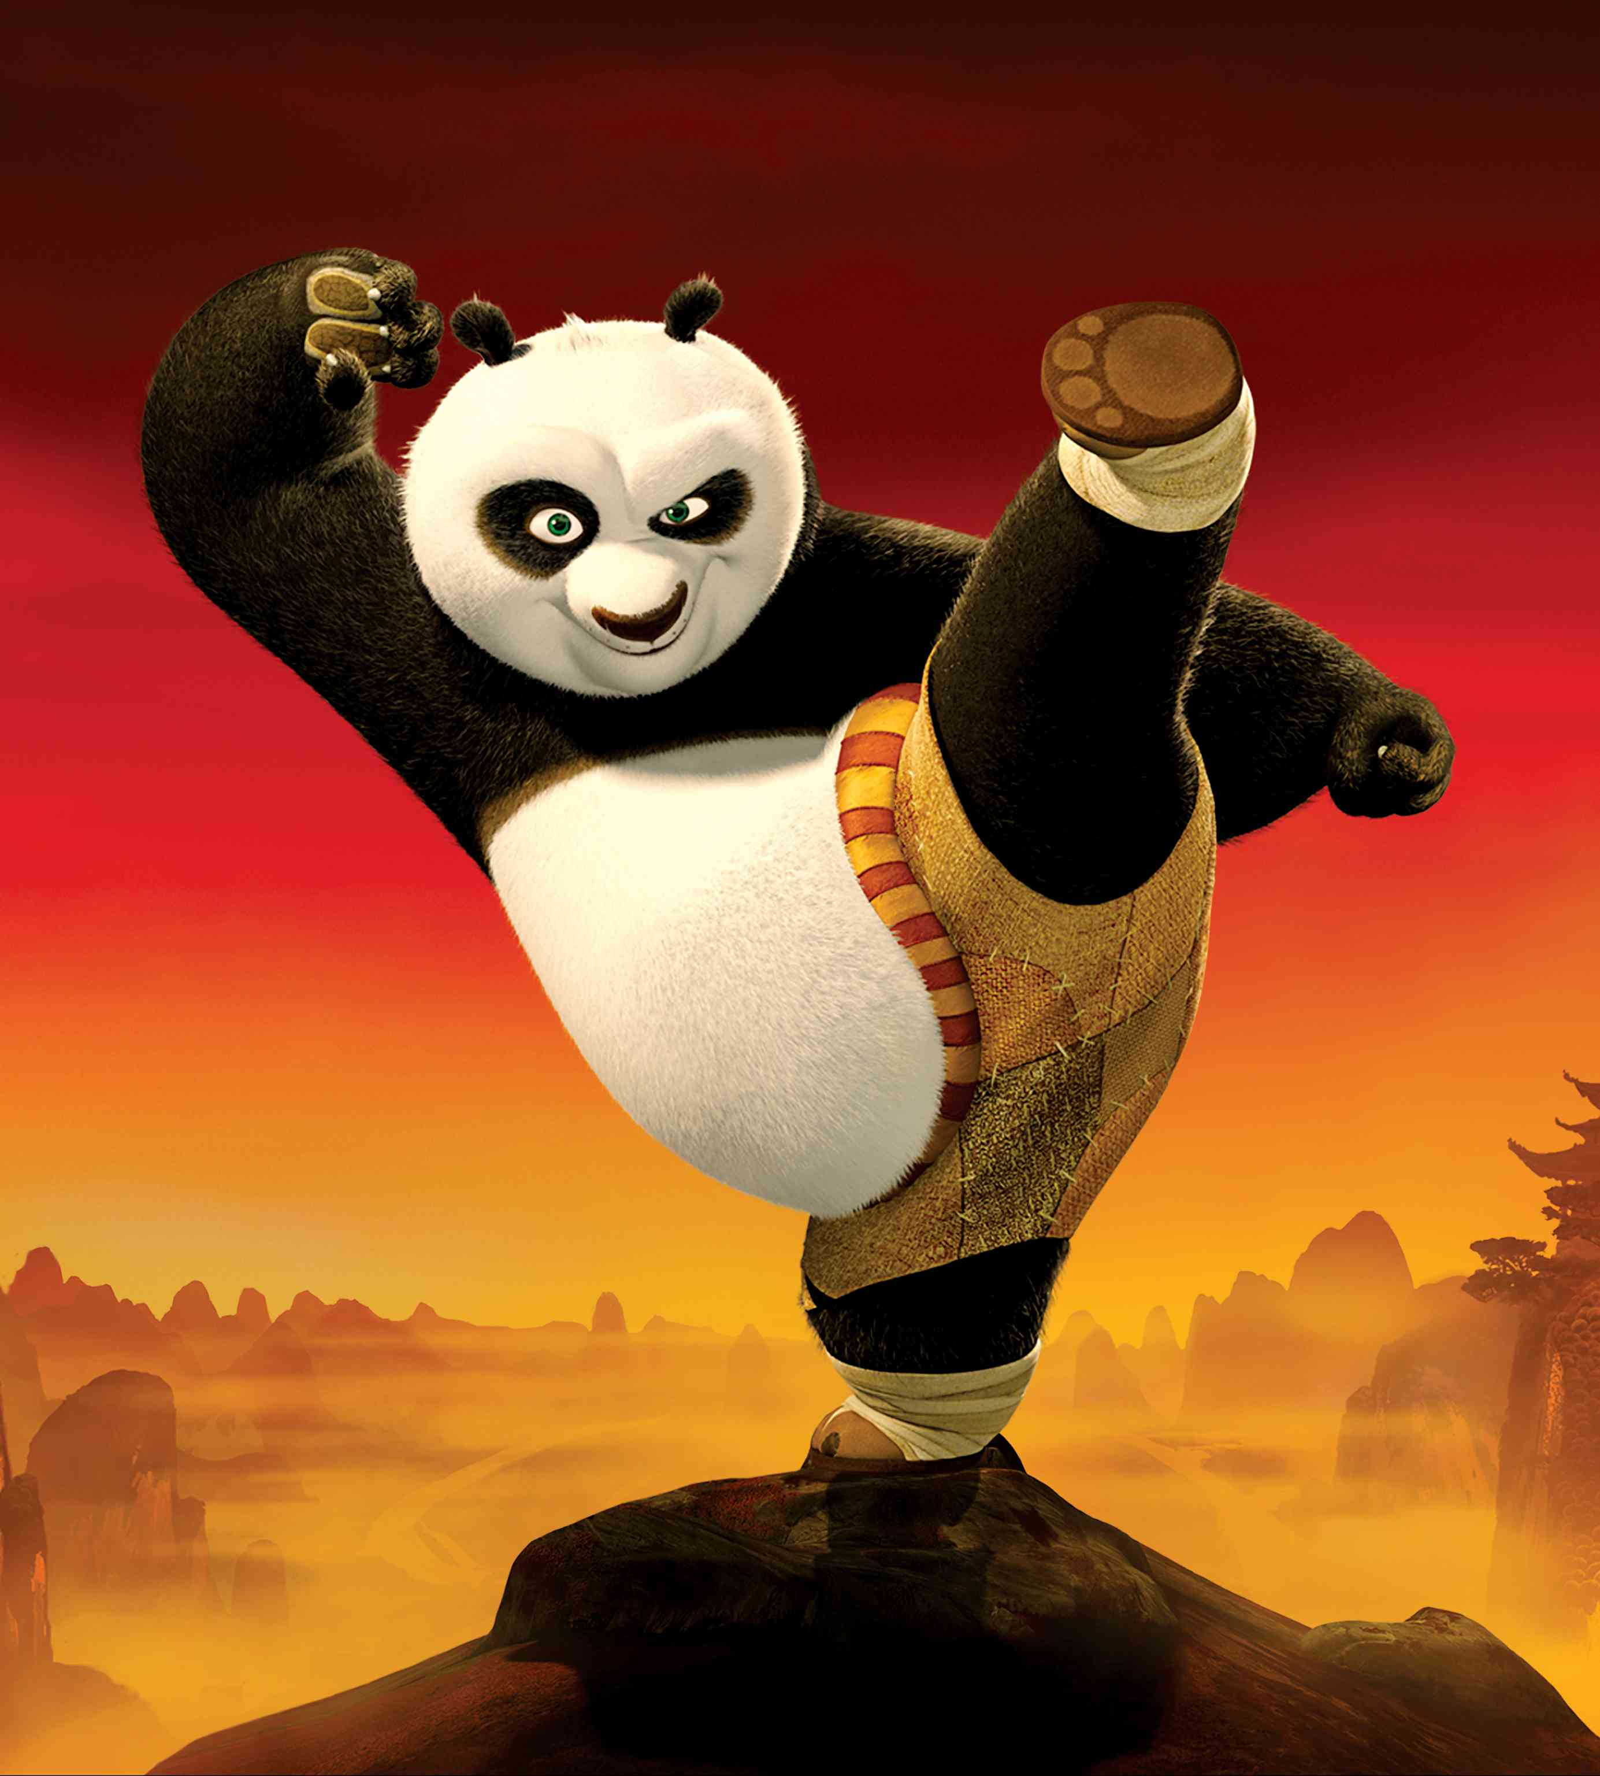
KUNG FU PANDA

Slide 13
“Don't worry. You're small and you're weak. That'll make you less of a target! They'll see you as sick or insane and go after the more Viking-like teens instead.”

Slide 14
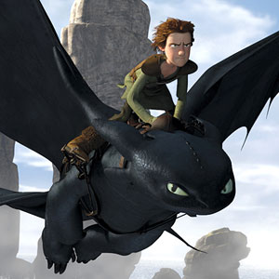
HOW TO TRAIN YOUR DRAGON

Slide 15
“Sunnyside is a place of ruin and despair, ruled by an evil bear who smells of strawberries!“

Slide 16
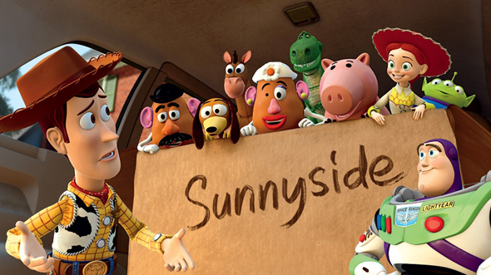
TOY STORY 3

Slide 17
“Blow dart? In my butt cheek! Really?!?”

Slide 18
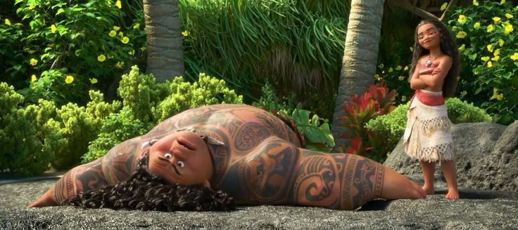
MOANA

Slide 19
“I'm taking in information! I'm processing! I'm doing the math, I'm fixing the boyfriend, and keeping the baby from turning into a flaming monster! How do I do it? By rolling with the punches, baby! I eat thunder and crap lightening…”

Slide 20
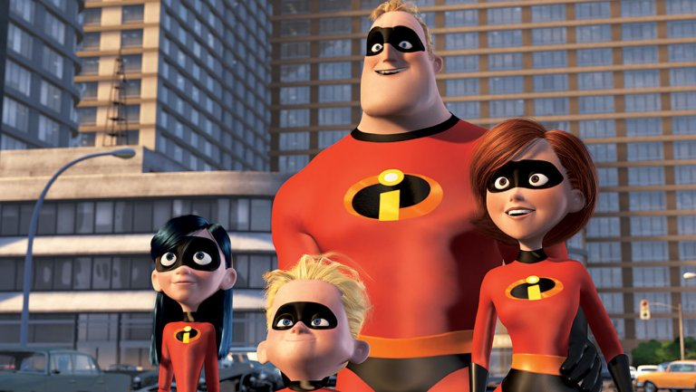
THE INCREDIBLES 2

Slide 23
You can be a
contributor
or a consumer

Slide 24
EVERY TEN MINUTES:
150 children die
of starvation
180 children die
from preventable
disease

Slide 25
EVERY TEN MINUTES:
20 children are
sold into slavery
1050 people die
70% without Christ
as their Savior

Slide 26
Will you use your time, money, and passions to contribute or to consume???

Slide 27
Do not let anyone look down on you because you are young. Instead set an example in speech, in life, in love, in faith, and in purity. ~1 Timothy 4:12

Slide 28
FIVE KINDS OF HARD

Slide 29
FIVE KINDS OF HARD
Do things that are _____ your ______ ______
Do things that ____ _____ what is _____ or ______
Ask God to do things you can ___ ___ ____ ___ ___

Slide 30
FIVE KINDS OF HARD
Do things that ____ ____ an
_______ ________
Do things that ______ the ____ ________ that the ______ ______ for you

Slide 31
FIVE KINDS OF HARD
Do things that
are outside your
comfort zone

Slide 32
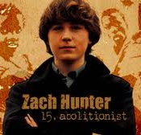

Slide 33
FIVE KINDS OF HARD
Do things that go beyond what is expected or required

Slide 35
FIVE KINDS OF HARD
Ask God to do things
you can only accomplish with
His help

Slide 36
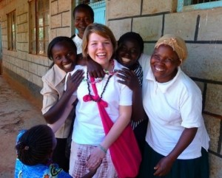
JAIME COLMAN

Slide 37
Now glory be to God! By his mighty power at work within us, he is able to accomplish infinitely more than we would ever dare to ask or hope.
~ EPHESIANS 3:20

Slide 39
FIVE KINDS OF HARD
Do things that don’t earn an immediate payoff

Slide 40
Whatever you eat or drink
or whatever you do, you must do all for the glory of God.
~ 1 Corinthians 10:31

Slide 41
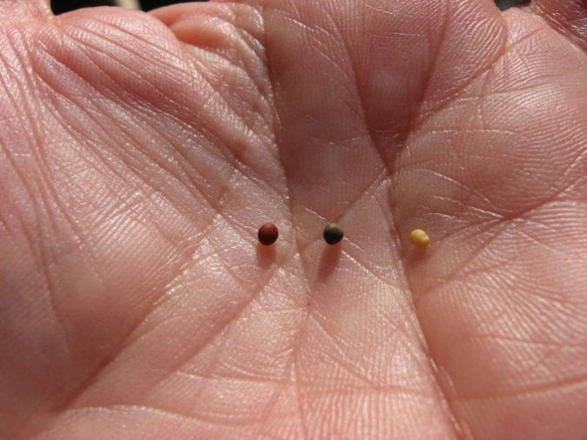
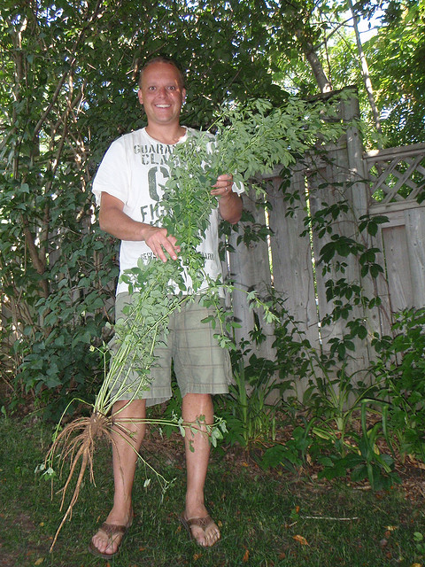
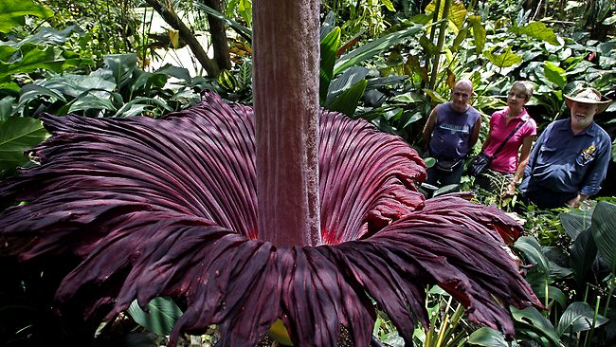

Slide 42
Whatever you do or say, let
it be as a representative of the Lord Jesus, all the while giving thanks through him
to God the Father.
~ Colossians 3:17

Slide 43
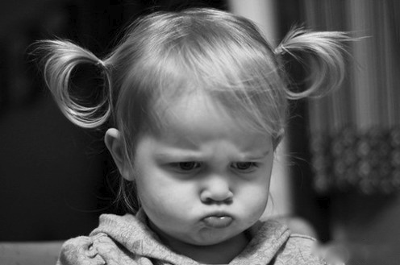

Slide 44
FIVE KINDS OF HARD
Do things that challenge the low expectations that the culture sets for you

Slide 45
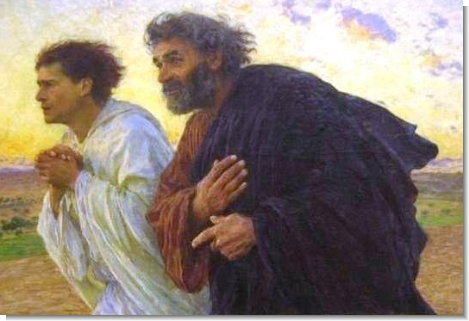
1 Timothy 4:12

Slide 46
