Slide 2
One person from each team will be picked to come to the front of the room. A task will appear on the screen, and we’ll see which team member will win!

Slide 3
1
Stand on one foot for 30 seconds

Slide 4
2
Name the capitol city of Michigan
Answer: Lansing

Slide 5
3
Do 10 jumping jacks

Slide 6
4
Hula-Hoop for 10 seconds

Slide 7
5
Find three pencils

Slide 8
6
Do 1 push-up on your fingertips

Slide 9
7
Hold your breath for 50 seconds

Slide 10
8
Do the splits the farthest down

Slide 11
9
Name two church staff members

Slide 12
10
Make a decent sized spit bubble

Slide 13
B
Rub your tummy, pat your head, and hop on one foot at the same time

Slide 14
B
L I
N D S
P O T S

Slide 15
SIN

Slide 17
GOSSIP
AND THE
POWER OF WORDS

Slide 18
PROVERBS 18:21
Life and death are in the power of the tongue, and those who love it will eat its fruits.

Slide 20
PROVERBS 15:4
Gentle words bring life and health…

Slide 21
ENTERTAINMENT STANDARDS

Slide 23
Mark 7:19-22
“Food doesn’t go into your heart, but only passes through the stomach and then goes into the sewer.” (By saying this, he declared that every kind of food is acceptable in God’s eyes.)

Slide 24
Mark 7:19-22
“It is what comes from inside that defiles you. For from within, out of a person’s heart, come evil thoughts, sexual immorality, theft, murder, adultery, greed, wickedness, deceit, lustful desires, envy, slander, pride, and foolishness.”

Slide 25
Proverbs 4:23
Guard your heart above all else, for it determines the course of your life.

Slide 26
Luke 6:45
“A good person produces good things from the treasury of a good heart, and an evil person produces evil things from the treasury of an evil heart. What you say flows from what is in your heart.”

Slide 27
PROVERBS 27:19
as a face is reflected in water, so the heart reflects the real person.

Slide 28
Character Formation Formula
What you put into your heart and mind is what you think about
What you think about is what you do
What you do becomes your behavior
Your behavior becomes your character
Your character is who you are

Slide 29
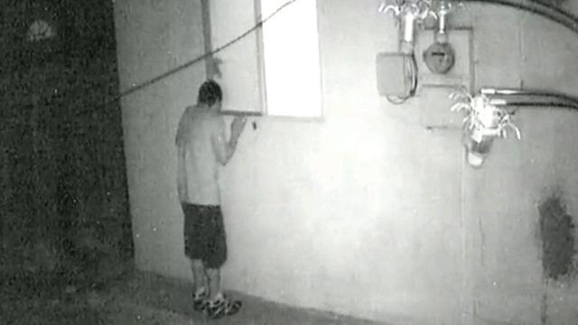

Slide 33
Colossians 3:1-4
Since you have been raised to new life with Christ, set your sights on the realities of heaven, where Christ sits in the place of honor at God’s right hand. Think about the things of heaven, not the things of earth.

Slide 34
Colossians 3:1-4
For you died to this life, and your real life is hidden with Christ in God. And when Christ, who is your life, is revealed to the whole world, you will share in all his glory.

Slide 35
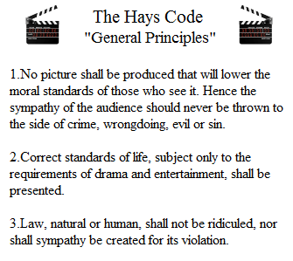

Slide 37
SEXUALITY
“So if your eye—even your good eye—causes you to lust, gouge it out and throw it away. It is better for you to lose one part of your body than for your whole body to be thrown into hell.”

Slide 38
PROFANITY
don’t use foul or abusive language. Let everything you say be good and helpful, so that your words will be an encouragement to those who hear them.

Slide 39
BLASPHEMY
You must not take the name of the Lord your God in vain. The Lord will not let you go unpunished if you misuse his name.

Slide 40
Violence
You [God] will keep in perfect peace all who trust in you, whose thoughts are fixed on you!

Slide 41
TIME
Teach us to realize the brevity of life,
so that we may grow in wisdom.

Slide 42
